Slide 1
Sheep Heart
Practice Exam #1

Slide 2
Name the following structures indicated by the arrows.
Click to the next slide to see the answer.
*For best results on these practice exams, write your answers on paper before clicking to see the correct answer. Try to answer within a minute (remember your lab exams will be timed) and make sure to check your spelling!
*note: not every structure you are required to know will be on this practice exercise so make sure you review the checklist of structures (p. 194 in your lab manual) when preparing for your lab exam

Slide 3
*click to the next slide to check your answer

Slide 4
Brachiocephalic trunk

Slide 5
*click to the next slide to check your answer

Slide 6
Auricle of right atrium

Slide 7
*click to the next slide to check your answer

Slide 8
Ligamentum arteriosum

Slide 9
*click to the next slide to check your answer

Slide 10
Aorta

Slide 11
*click to the next slide to check your answer

Slide 12
Left pulmonary artery

Slide 13
*click to the next slide to check your answer

Slide 14
Right ventricle

Slide 15
*click to the next slide to check your answer

Slide 16
Auricle of left atrium

Slide 17
*click to the next slide to check your answer

Slide 18
Anterior interventricular sulcus

Slide 19
*click to the next slide to check your answer

Slide 20
Superior vena cava

Slide 21
*click to the next slide to check your answer

Slide 22
Posterior interventricular sulcus

Slide 23
*click to the next slide to check your answer

Slide 24
Inferior vena cava

Slide 25
*click to the next slide to check your answer

Slide 26
Tricuspid valve

Slide 27
*click to the next slide to check your answer

Slide 28
Moderator band

Slide 29
*click to the next slide to check your answer

Slide 30
Pulmonary semilunar valve

Slide 31
*click to the next slide to check your answer

Slide 32
Papillary muscle

Slide 33
*click to the next slide to check your answer

Slide 34
Interventricular septum

Slide 35
*click to the next slide to check your answer

Slide 36
Pulmonary trunk

Slide 37
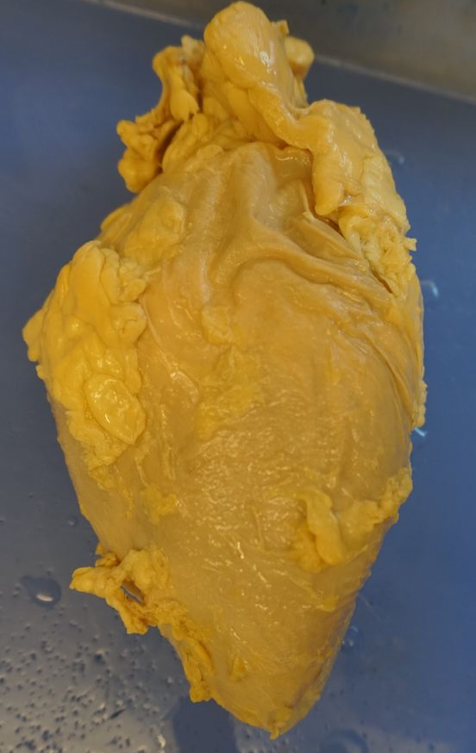
*click to the next slide to check your answer

Slide 38
pericardial sac

