Slide 1
Nervous System Lab
Practice Exam #2

Slide 2
Name the following structures indicated by the arrows.
Click to the next slide to see the answer.
*For best results on these practice exams, write your answers on paper before clicking to see the correct answer. Try to answer within a minute (remember your lab exams will be timed) and make sure to check your spelling!
*note: not every structure you are required to know will be on this practice exercise so make sure you review the checklist of structures (p. 136-137 in your lab manual) when preparing for your lab exam

Slide 3
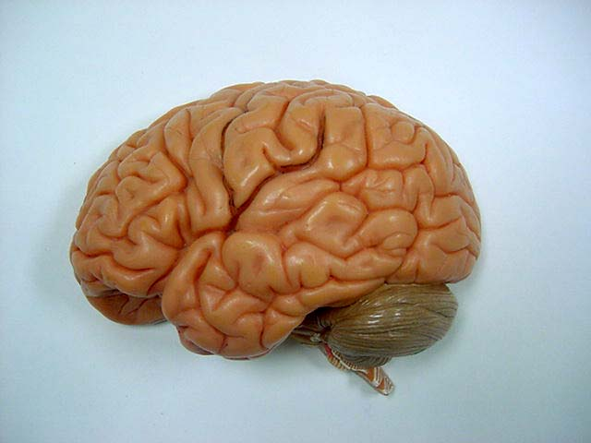
*click to the next slide to check your answer

Slide 4
Lateral sulcus

Slide 5
*click to the next slide to check your answer

Slide 6
Transverse fissure

Slide 7
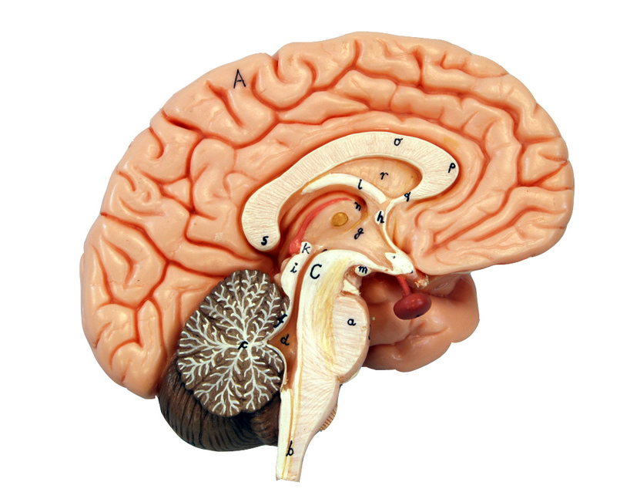
*click to the next slide to check your answer

Slide 8
Arbor vitae of cerebellum

Slide 9
*click to the next slide to check your answer

Slide 10
Spinal cord

Slide 11
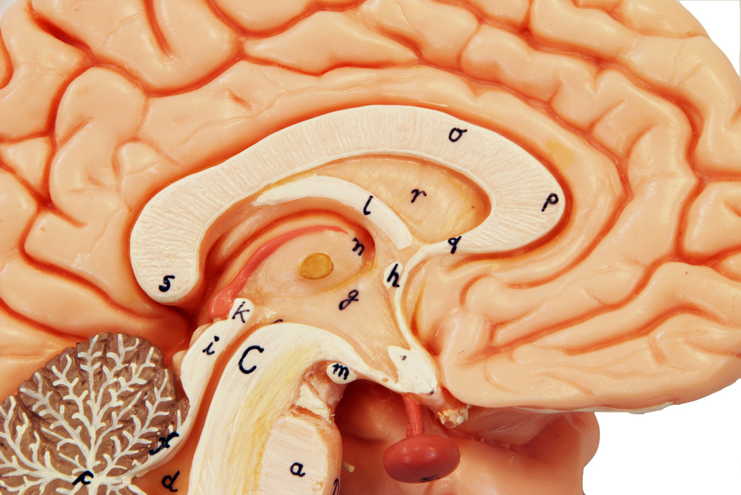
*click to the next slide to check your answer

Slide 12
Hypothalamus

Slide 13
*click to the next slide to check your answer

Slide 14
Mamillary body

Slide 15
*click to the next slide to check your answer

Slide 16
Infundibulum

Slide 17
*click to the next slide to check your answer

Slide 18
Folia of cerebellum

Slide 19
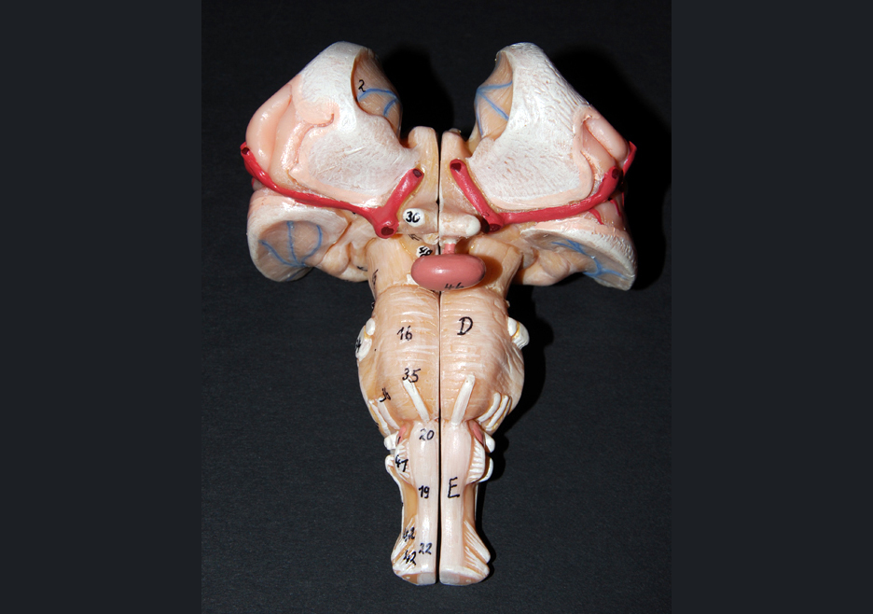
*click to the next slide to check your answer

Slide 20
Pons

Slide 21
*click to the next slide to check your answer

Slide 22
Abducens nerve (VI)

Slide 23
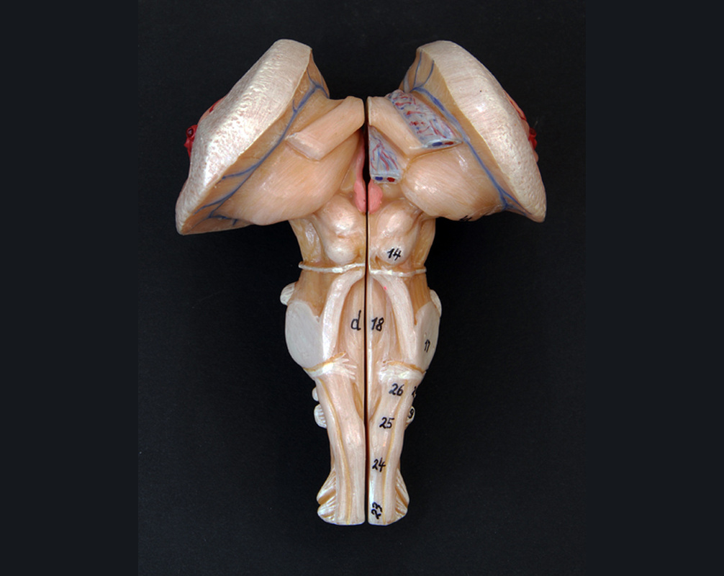
*click to the next slide to check your answer

Slide 24
Pineal gland

Slide 25
*click to the next slide to check your answer

Slide 26
Inferior colliculus

Slide 27
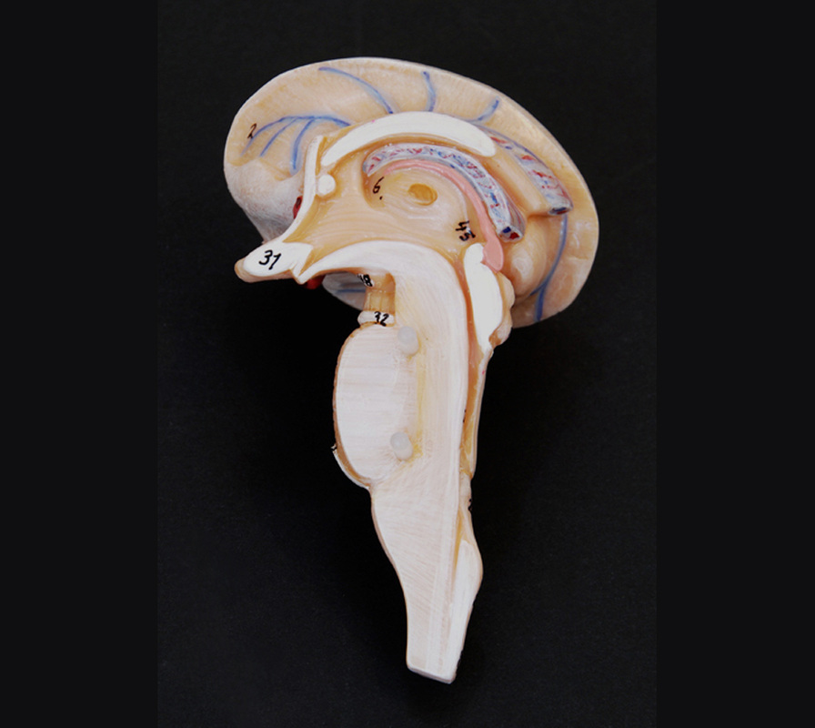
*click to the next slide to check your answer

Slide 28
Intermediate mass of the thalamus

Slide 29
*click to the next slide to check your answer

Slide 30
Cerebral aqueduct of the midbrain

Slide 31
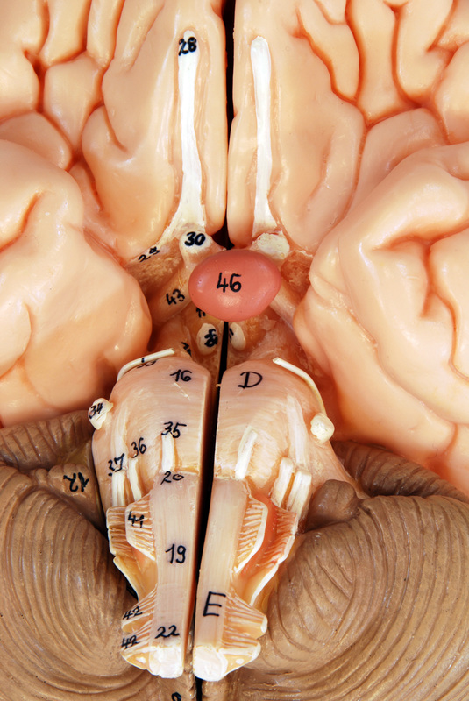
*click to the next slide to check your answer

Slide 32
Olfactory tract

Slide 33
*click to the next slide to check your answer

Slide 34
Facial nerve (VII)

Slide 35
*click to the next slide to check your answer

Slide 36
Accessory nerve (XI)

Slide 37
*click to the next slide to check your answer

Slide 38
Optic nerve (II)

Slide 39
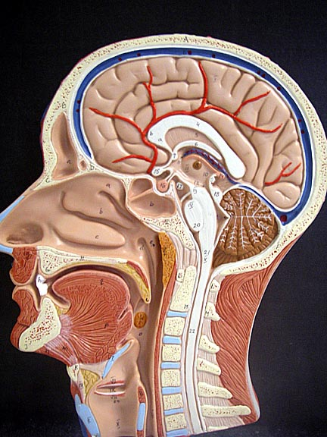
*click to the next slide to check your answer

Slide 40
Pituitary gland

Slide 41
*click to the next slide to check your answer

Slide 42
Superior sagittal sinus

Slide 43
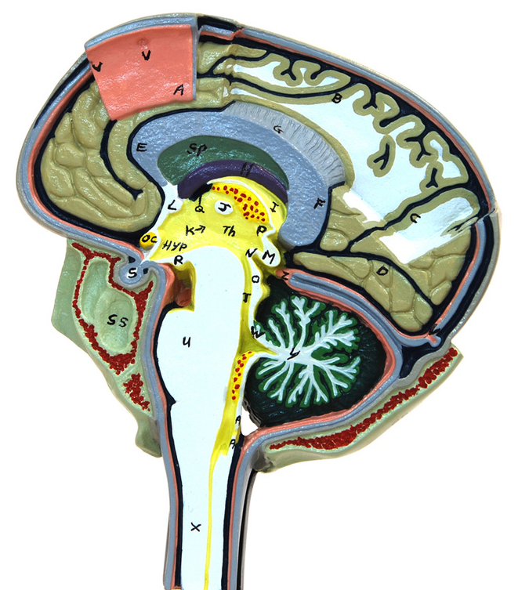
*click to the next slide to check your answer

Slide 44
Subarachnoid space

Slide 45
*click to the next slide to check your answer

Slide 46
Arachnoid granulation (arachnoid villus)

Slide 47
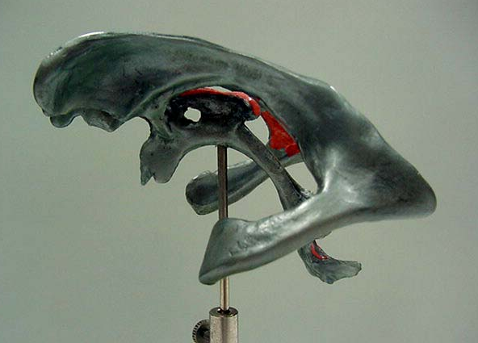
*click to the next slide to check your answer

Slide 48
Interventricular foramen

Slide 49
*click to the next slide to check your answer

Slide 50
Spinal nerve

Slide 51
*click to the next slide to check your answer

Slide 52
Dura mater

Slide 53
*click to the next slide to check your answer

Slide 54
Anterior white column

Slide 55
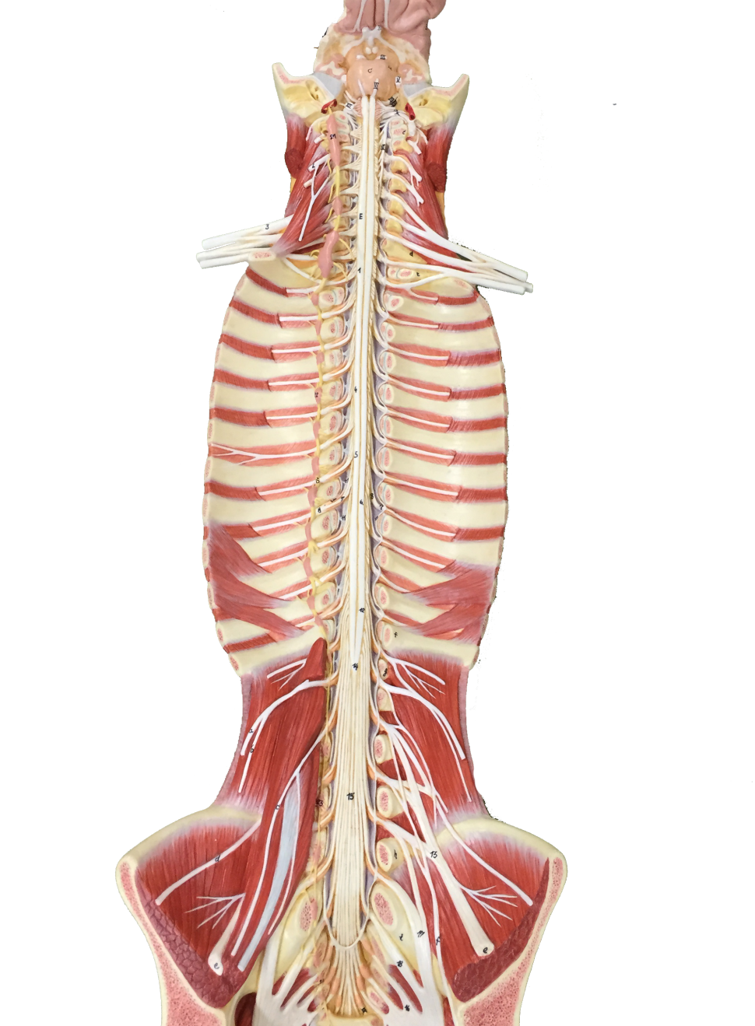
*click to the next slide to check your answer

Slide 56
Conus medullaris

Slide 57
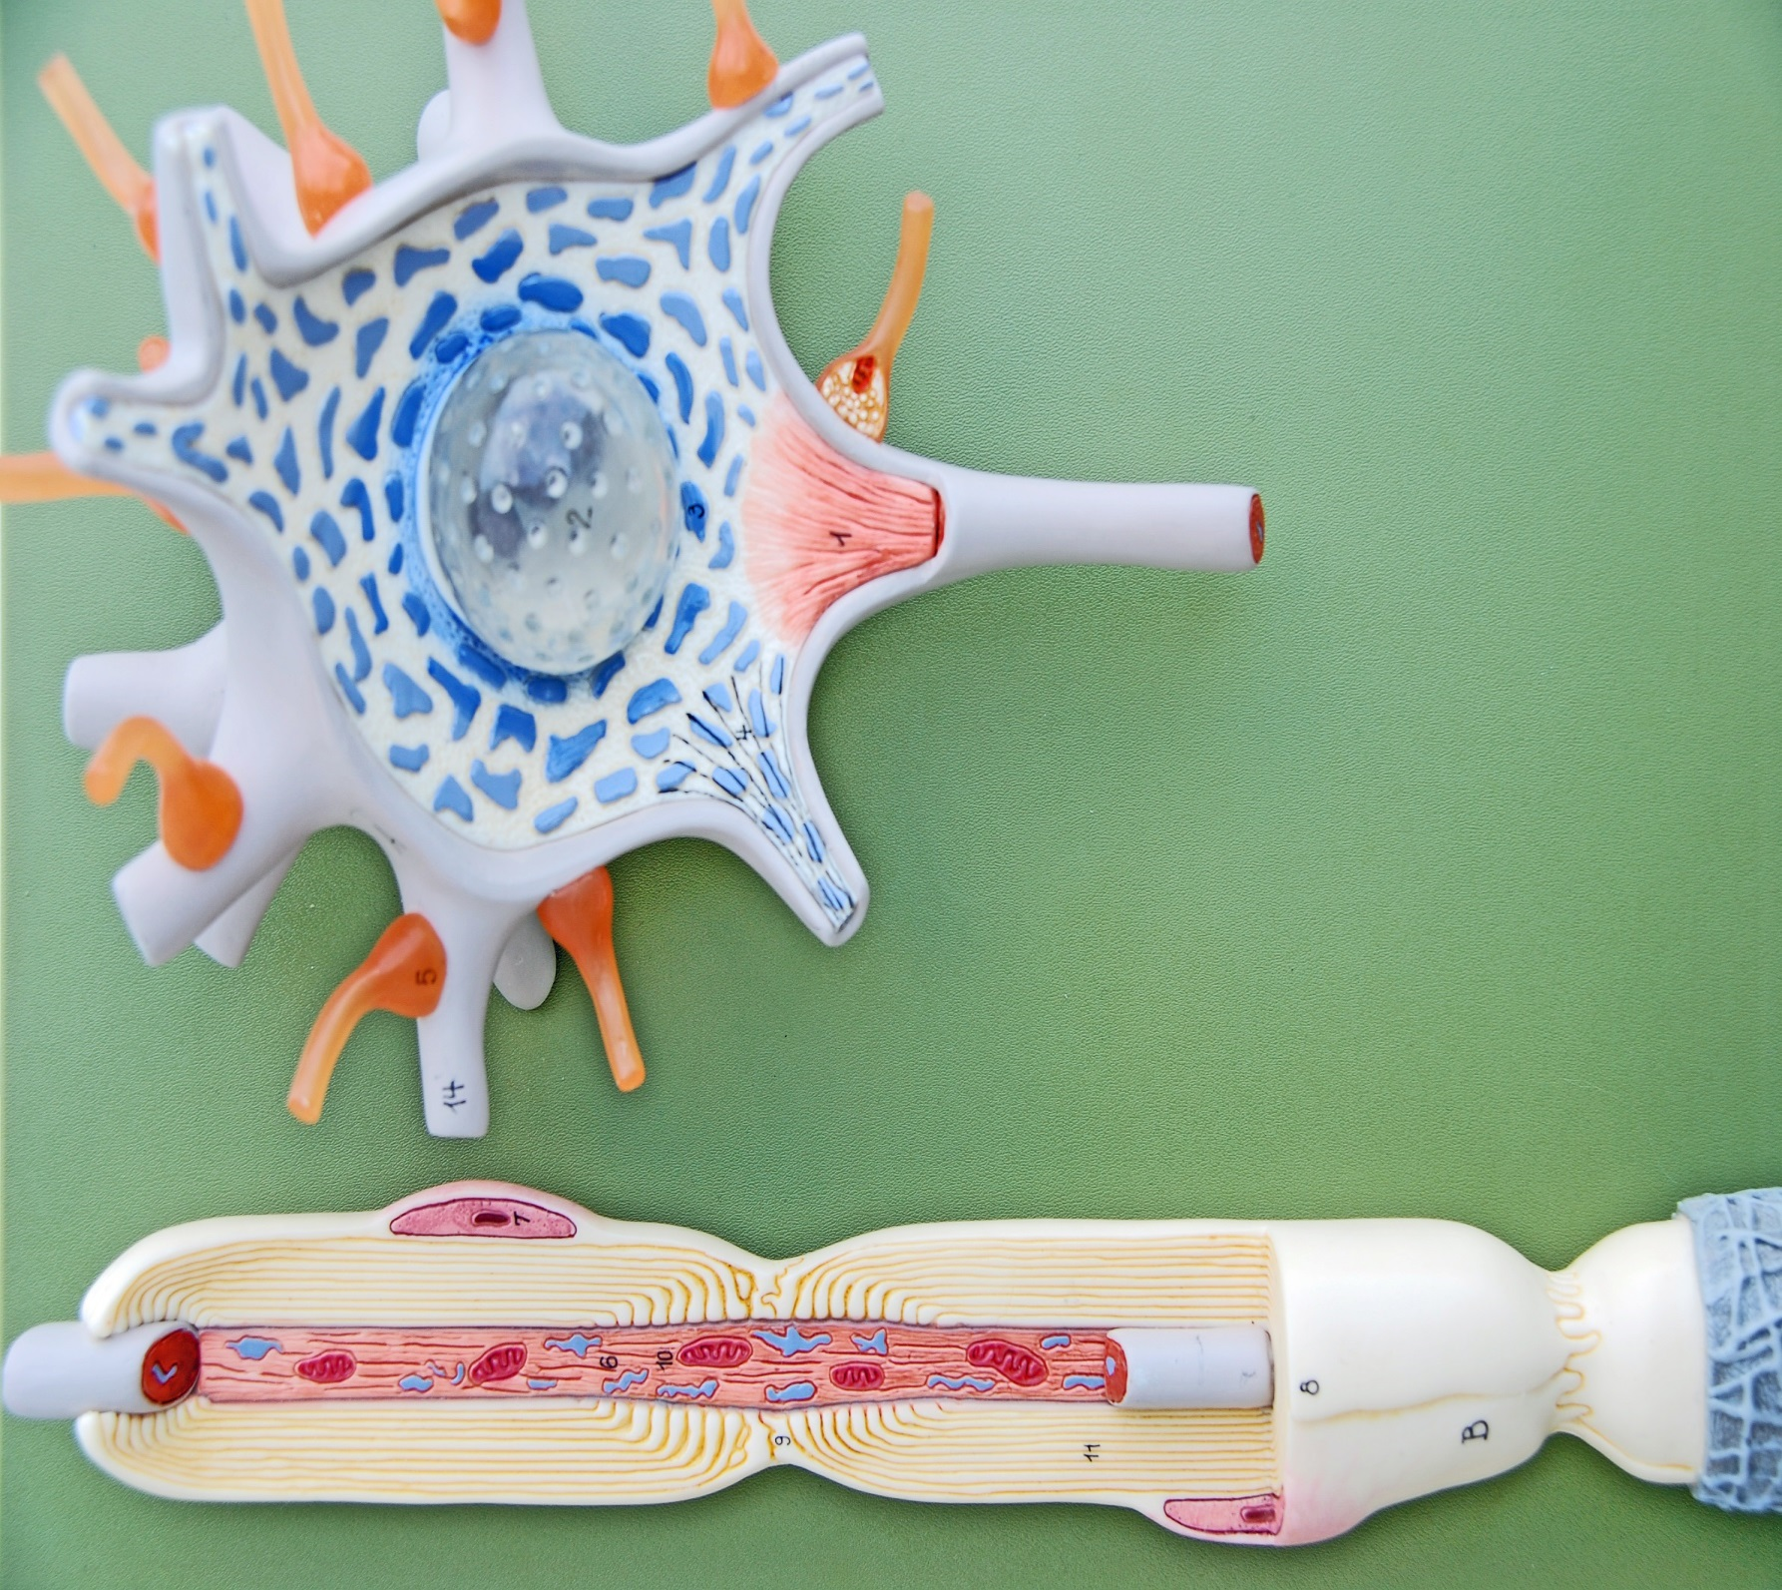
*click to the next slide to check your answer

Slide 58
Axon hillock

Slide 59
*click to the next slide to check your answer

Slide 60
Myelin sheath

Slide 61
*click to the next slide to check your answer

Slide 62
Dendrite

