Slide 1
Nervous System Lab
Practice Exam #1

Slide 2
Name the following structures indicated by the arrows.
Click to the next slide to see the answer.
*For best results on these practice exams, write your answers on paper before clicking to see the correct answer. Try to answer within a minute (remember your lab exams will be timed) and make sure to check your spelling!
*note: not every structure you are required to know will be on this practice exercise so make sure you review the checklist of structures (p. 136-137 in your lab manual) when preparing for your lab exam

Slide 3
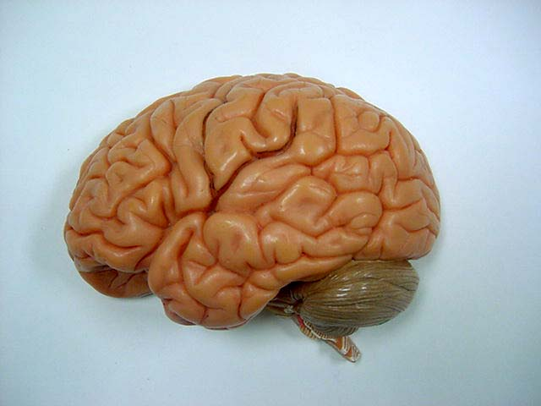
*click to the next slide to check your answer

Slide 4
Central sulcus

Slide 5
*click to the next slide to check your answer

Slide 6
Temporal lobe

Slide 7
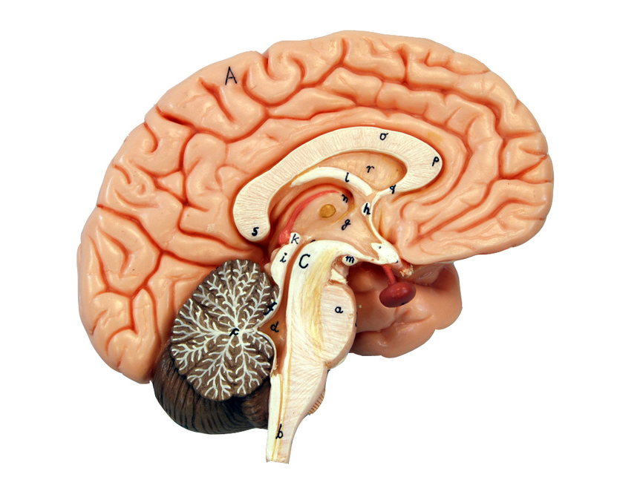
*click to the next slide to check your answer

Slide 8
Septum pellucidum

Slide 9
*click to the next slide to check your answer

Slide 10
Medulla oblongata

Slide 11
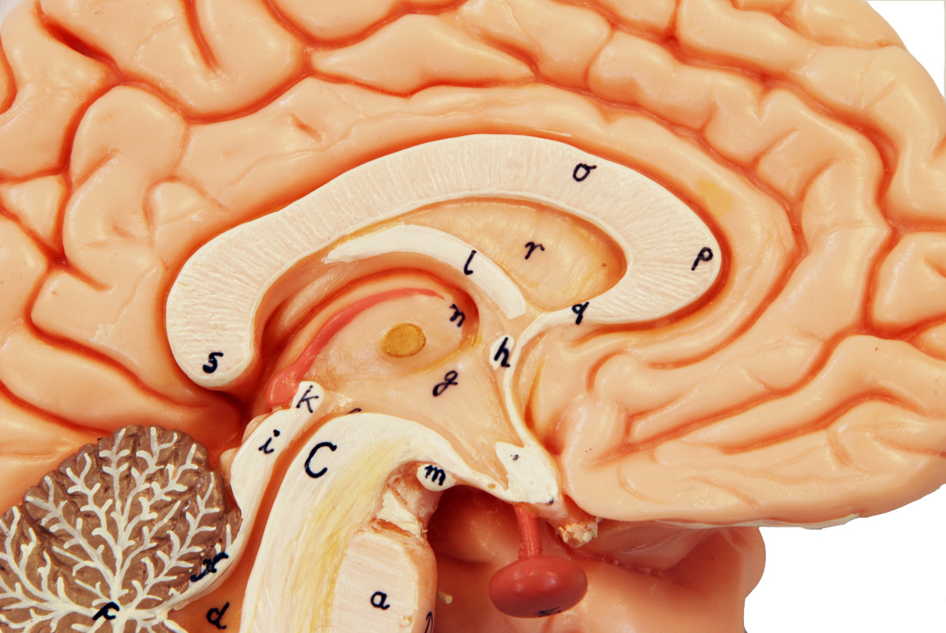
*click to the next slide to check your answer

Slide 12
Cerebral aqueduct of the midbrain

Slide 13
*click to the next slide to check your answer

Slide 14
Corpus callosum

Slide 15
*click to the next slide to check your answer

Slide 16
Intermediate mass of thalamus

Slide 17
*click to the next slide to check your answer

Slide 18
Vermis of cerebellum

Slide 19
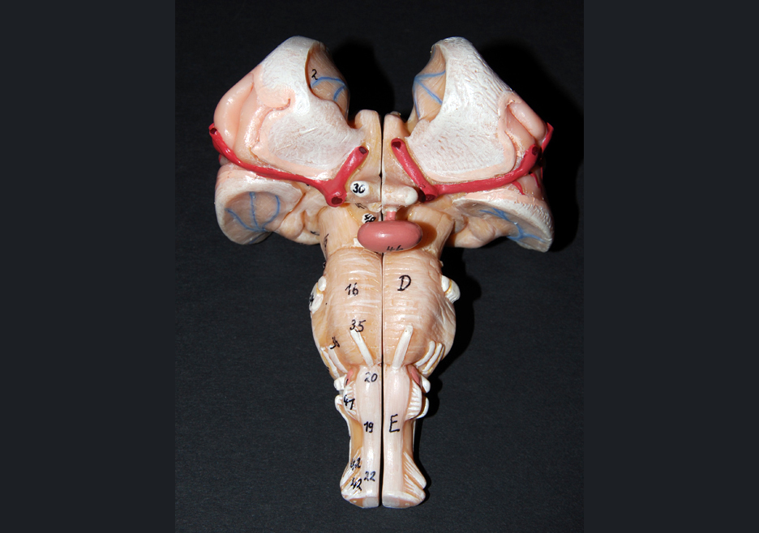
*click to the next slide to check your answer

Slide 20
Cerebral peduncle of the midbrain

Slide 21
*click to the next slide to check your answer

Slide 22
Pituitary gland

Slide 23
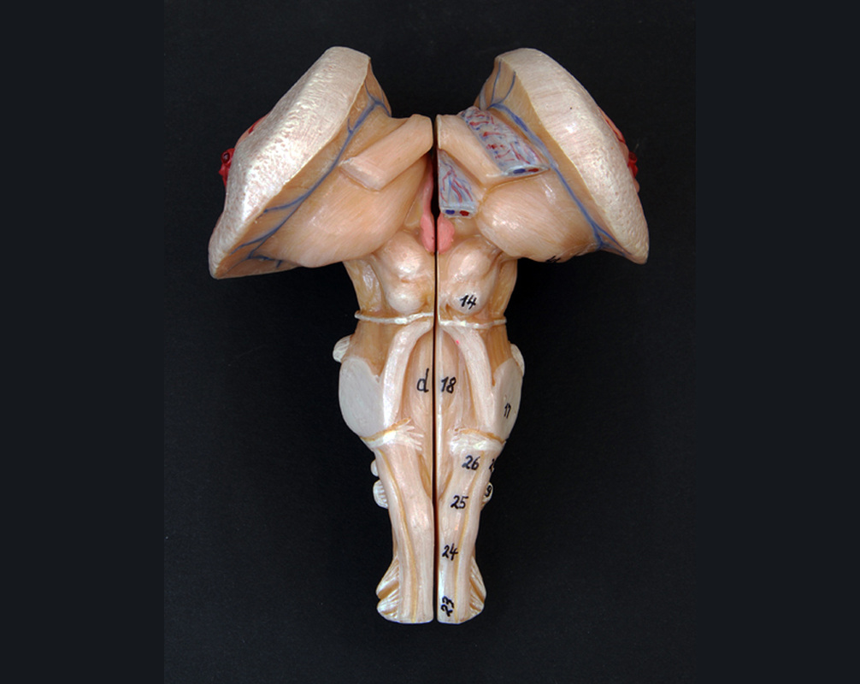
*click to the next slide to check your answer

Slide 24
Thalamus

Slide 25
*click to the next slide to check your answer

Slide 26
Superior colliculus

Slide 27
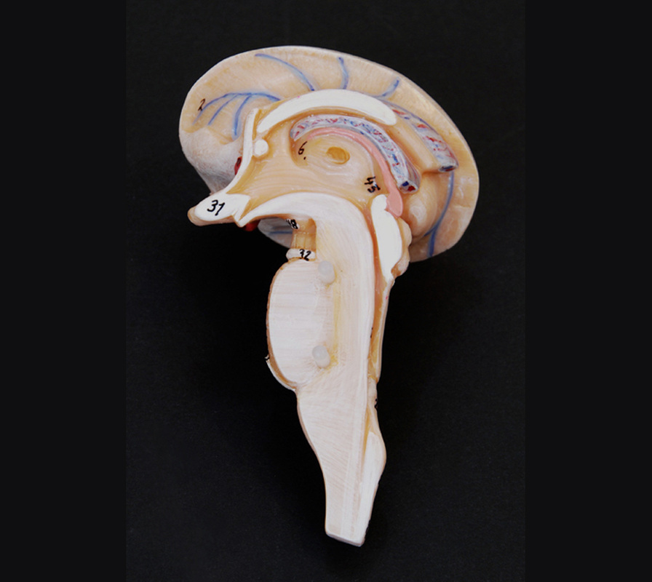
*click to the next slide to check your answer

Slide 28
Hypothalamus

Slide 29
*click to the next slide to check your answer

Slide 30
Mamillary body

Slide 31
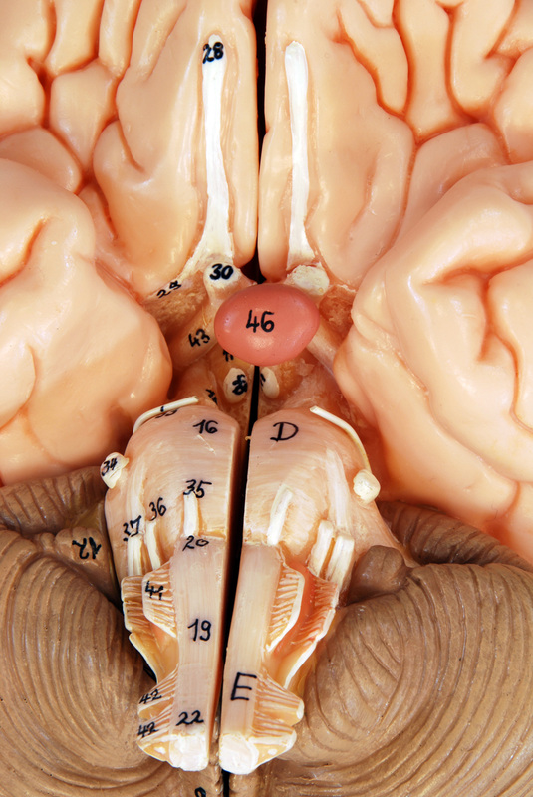
*click to the next slide to check your answer

Slide 32
Olfactory bulb (I)

Slide 33
*click to the next slide to check your answer

Slide 34
Trigeminal nerve (V)

Slide 35
*click to the next slide to check your answer

Slide 36
Optic tract

Slide 37
*click to the next slide to check your answer

Slide 38
Hypoglossal nerve (XII)

Slide 39
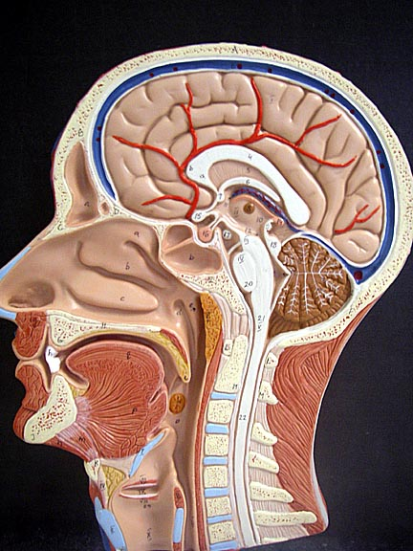
*click to the next slide to check your answer

Slide 40
Infundibulum

Slide 41
*click to the next slide to check your answer

Slide 42
Pineal gland

Slide 43
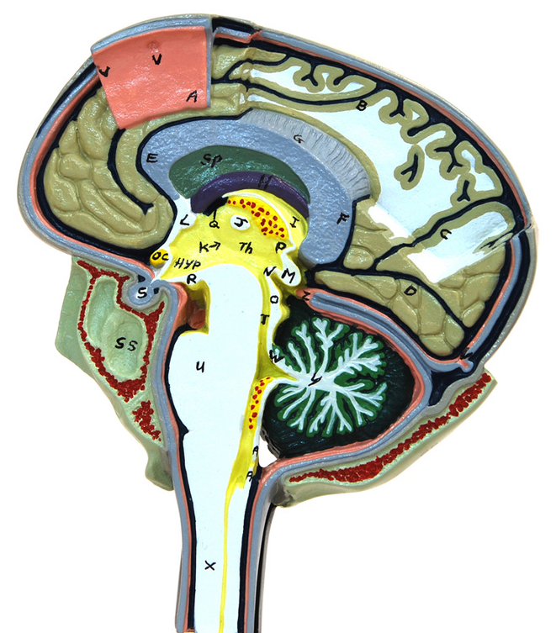
*click to the next slide to check your answer

Slide 44
Cranial dura mater

Slide 45
*click to the next slide to check your answer

Slide 46
Superior sagittal sinus

Slide 47
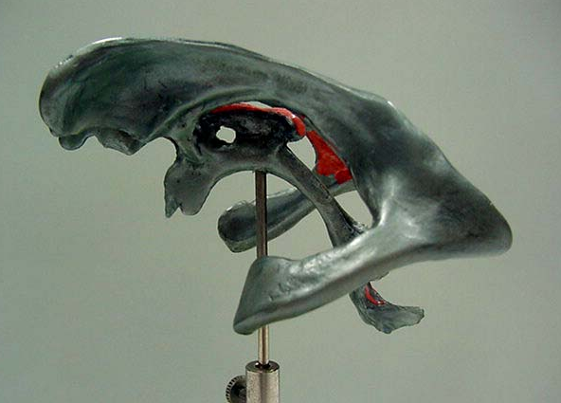
*click to the next slide to check your answer

Slide 48
Third ventricle

Slide 49
*click to the next slide to check your answer

Slide 50
Pia mater

Slide 51
*click to the next slide to check your answer

Slide 52
Posterior gray horn

Slide 53
*click to the next slide to check your answer

Slide 54
Subarachnoid space

Slide 55
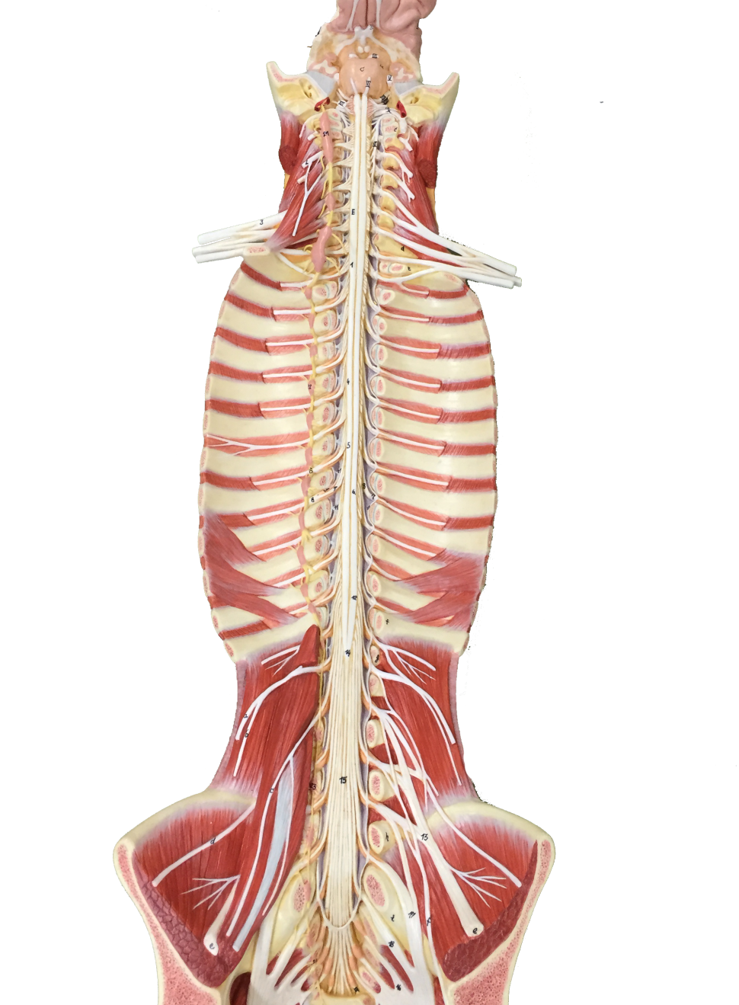
*click to the next slide to check your answer

Slide 56
Cauda equina

Slide 57
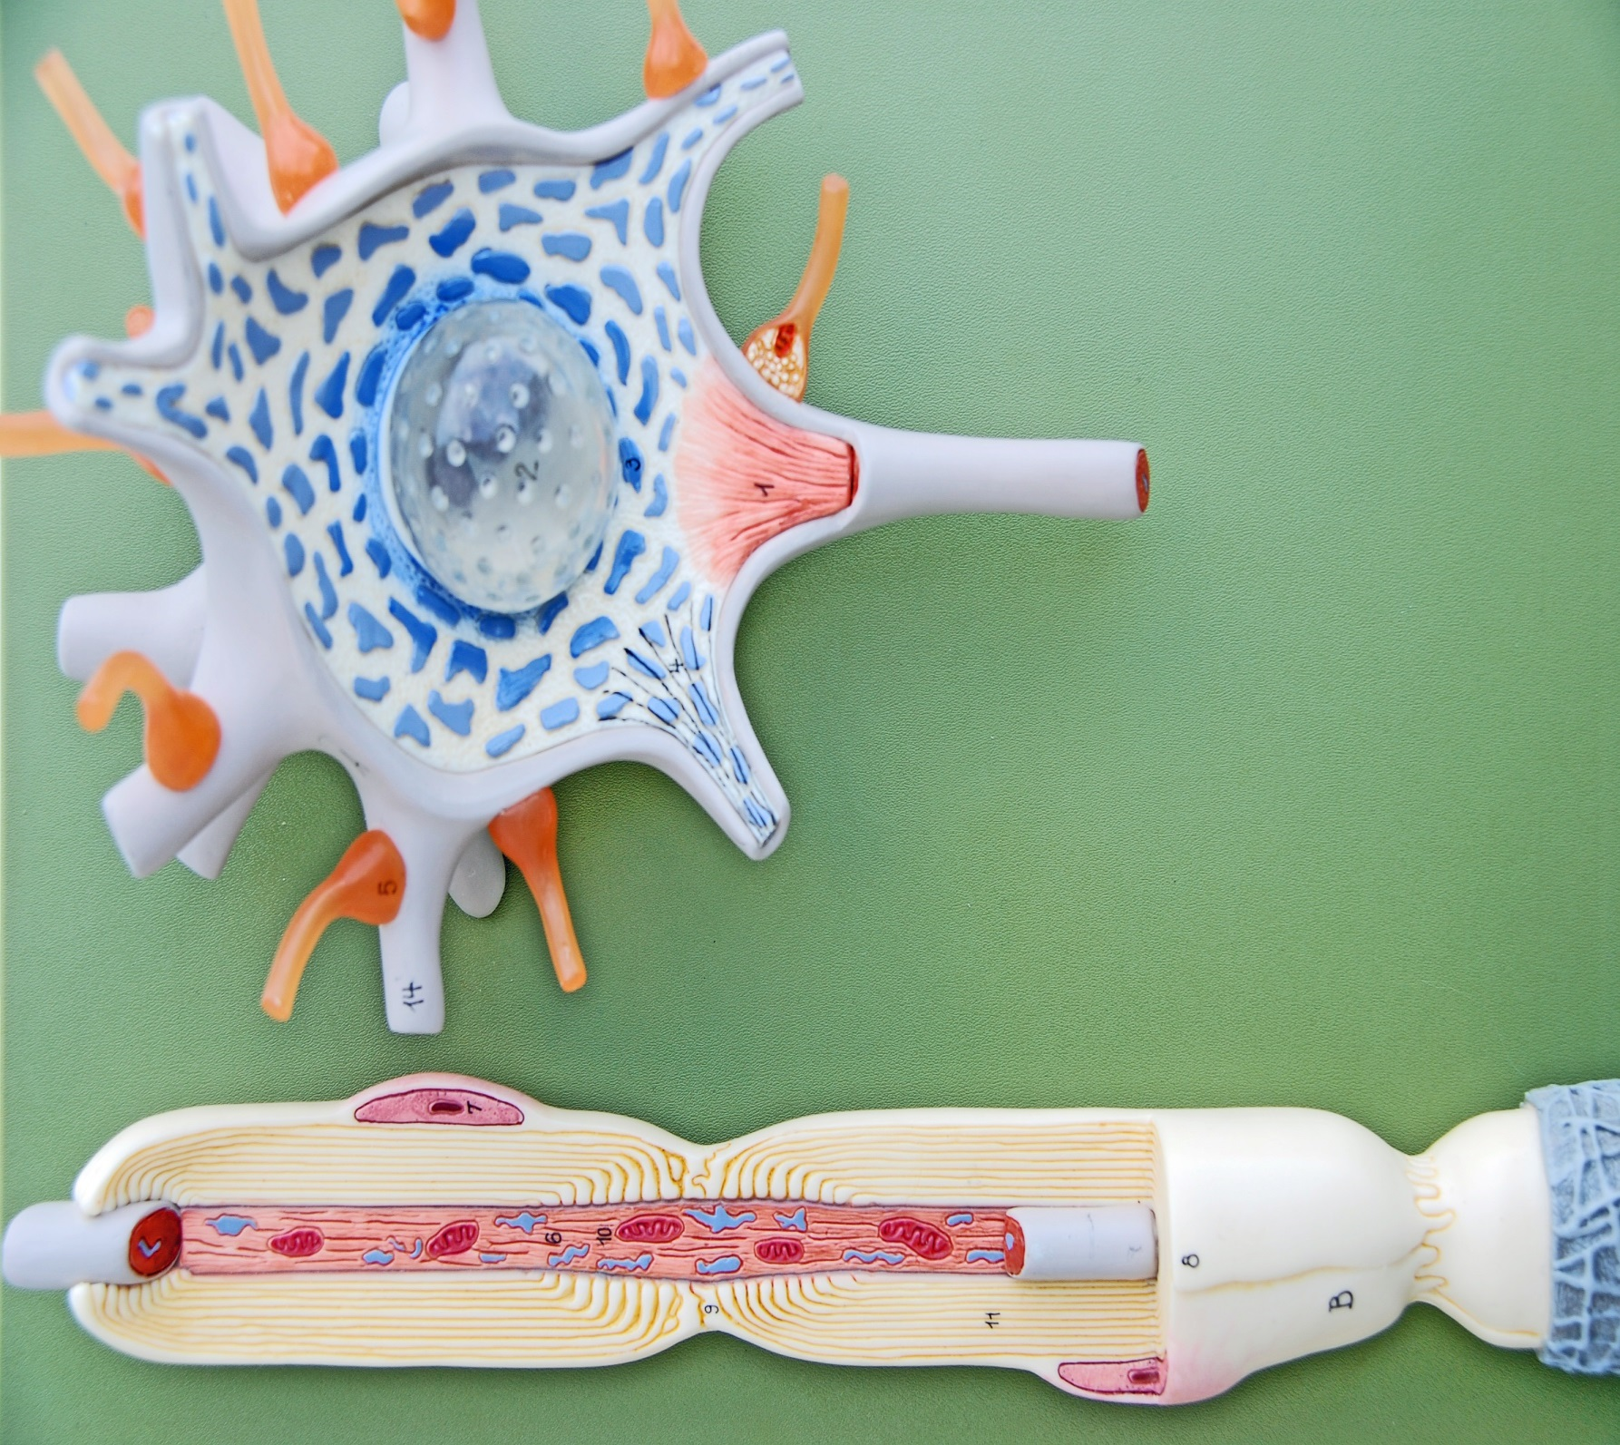
*click to the next slide to check your answer

Slide 58
Axon

Slide 59
*click to the next slide to check your answer

Slide 60
Synaptic terminal (synaptic end bulb)

Slide 61
*click to the next slide to check your answer

Slide 62
Node of Ranvier

