Slide 1
Skeletal Muscle
Practice Exam #1

Slide 2
Name the following muscles indicated by the arrows and describe their actions.
Click to the next slide to see the answer.
*For best results on these practice exams, write your answers on paper before clicking to see the correct answer. Try to answer within a minute (remember your lab exams will be timed) and make sure to check your spelling!
*note: not every muscle you are required to know will be on this practice exercise so make sure you review the checklist of structures (p. 110 in your lab manual) when preparing for your lab exam

Slide 3
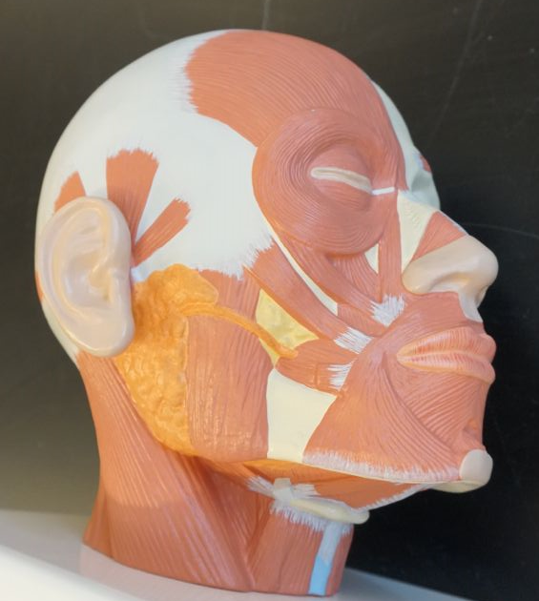
*click to the next slide to check your answer

Slide 4
Orbicularis oculi
Action: Closes eye/squeezes eye shut

Slide 5
*click to the next slide to check your answer

Slide 6
Masseter
Action: Elevates mandible

Slide 7
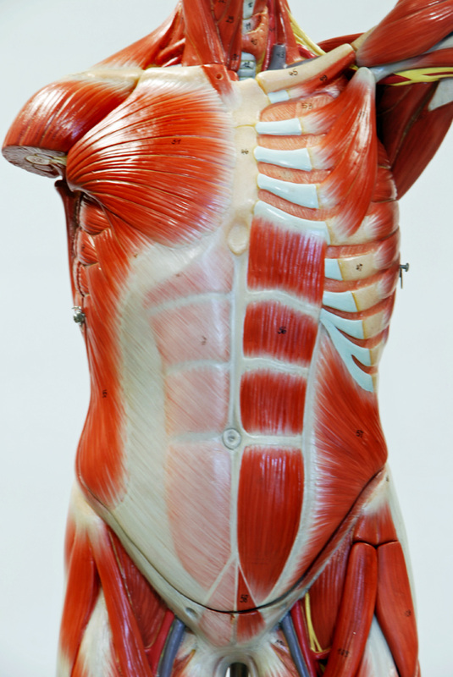
*click to the next slide to check your answer

Slide 8
Internal intercostals
Action: Pulls ribs inferiorly to cause expiration (exhalation)

Slide 9
*click to the next slide to check your answer

Slide 10
Rectus abdominis
Action: Flexion of torso at vertebral column

Slide 11
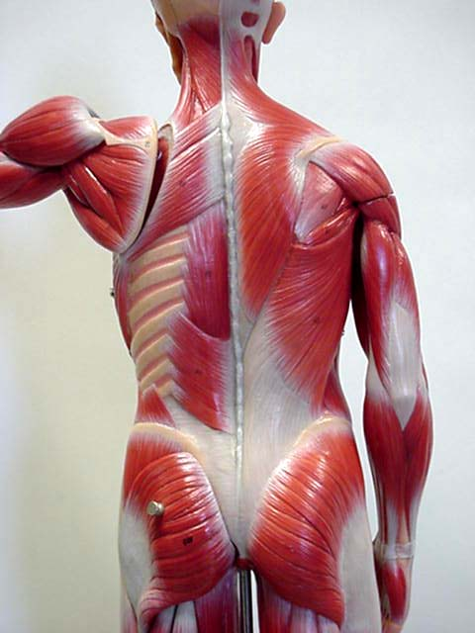
*click to the next slide to check your answer

Slide 12
Trapezius
Action: Elevation, retraction or depression of the scapula; Extension of the head and neck

Slide 13
*click to the next slide to check your answer

Slide 14
Erector spinae
Action: Extension of vertebral column with bilateral contraction; Rotation and lateral flexion of spine with unilateral contraction

Slide 15
*click to the next slide to check your answer

Slide 16
Rhomboid major
Action: Retraction of the scapula

Slide 17
*click to the next slide to check your answer

Slide 18
Latissimus dorsi
Action: Extension, adduction and medial rotation of the arm at the shoulder

Slide 19
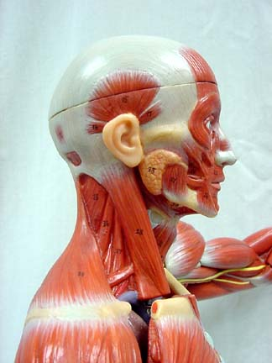
*click to the next slide to check your answer

Slide 20
Action: Flexion of the head and neck with bilateral (both left and right) contraction; Lateral flexion and rotation of the head and neck with unilateral contraction
Sternocleidomastoid

Slide 21
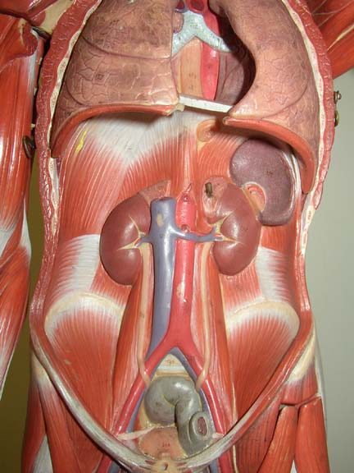
*click to the next slide to check your answer

Slide 22
Diaphragm
Action: Contraction causes inspiration (inhalation) by increasing the volume of the thoracic cavity

Slide 23
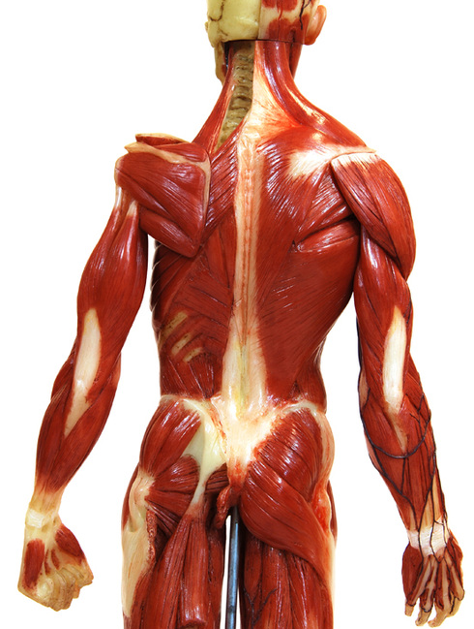
*click to the next slide to check your answer

Slide 24
Levator scapulae
Action: Elevation of the scapula

Slide 25
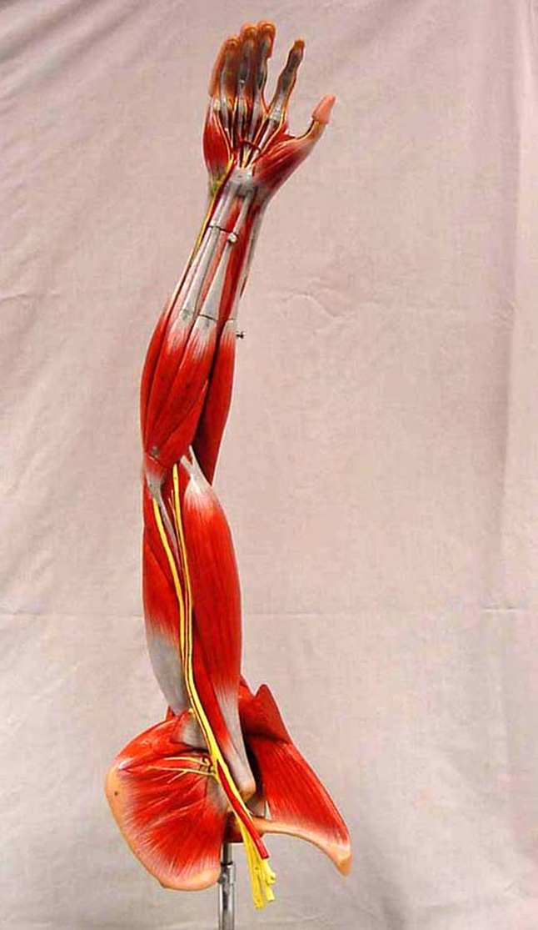
*click to the next slide to check your answer

Slide 26
Action: Flexion at the elbow and supination of the forearm
Biceps brachii

Slide 27
*click to the next slide to check your answer

Slide 28
Action: Internal (medial) rotation of the arm at the shoulder
Subscapularis

Slide 29
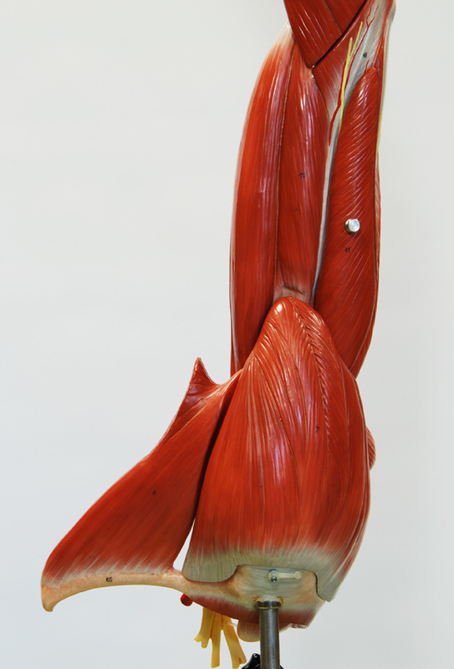
*click to the next slide to check your answer

Slide 30
Action: Abduction, flexion or extension of the arm at the shoulder
Deltoid

Slide 31
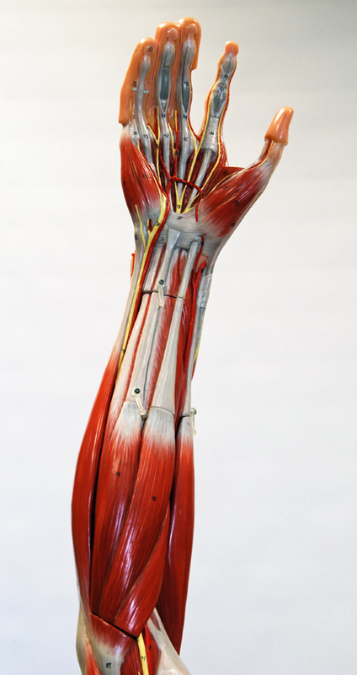
*click to the next slide to check your answer

Slide 32
Action: Flexion and abduction (radial deviation) at the wrist
Flexor carpi radialis

Slide 33
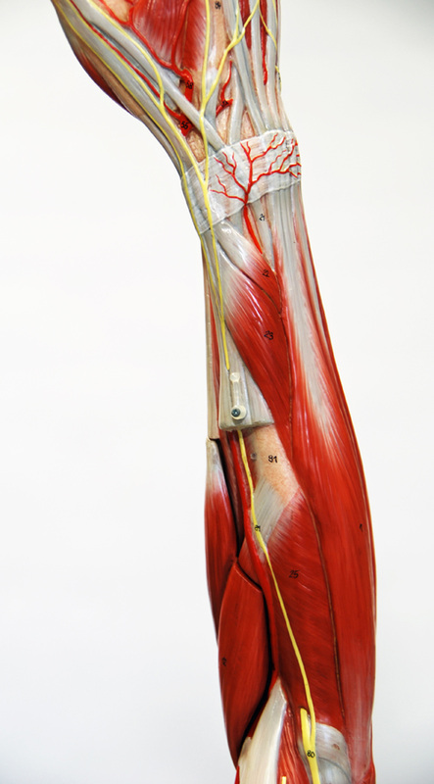
*click to the next slide to check your answer

Slide 34
Action: Supination of the forearm
Supinator

Slide 35
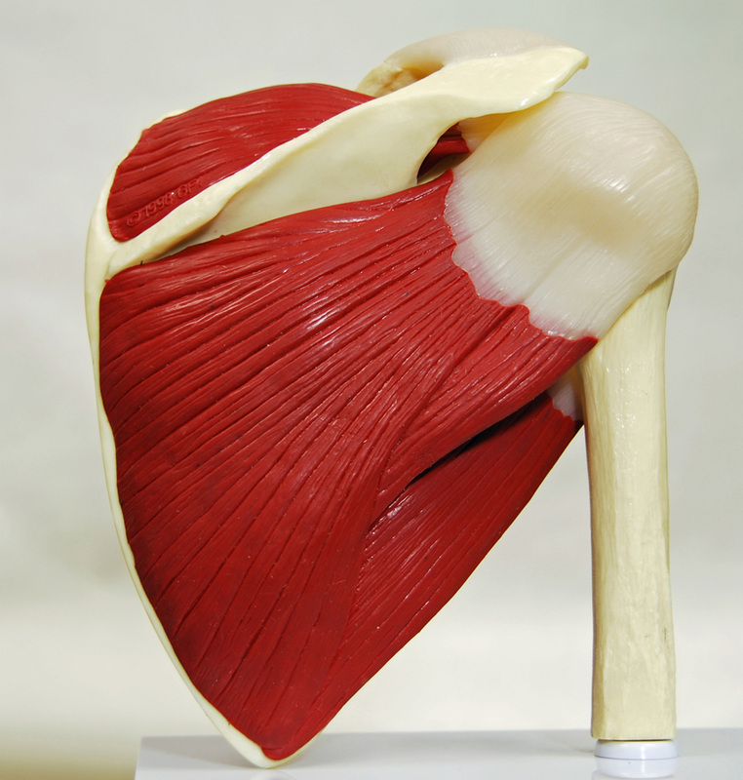
*click to the next slide to check your answer

Slide 36
Supraspinatus
Action: Abduction of the arm at the shoulder

Slide 37
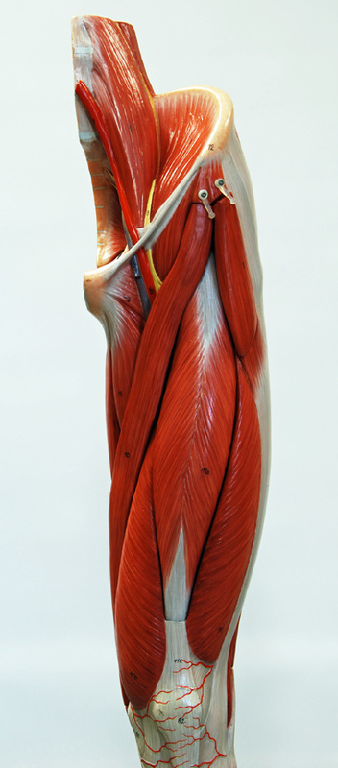
*click to the next slide to check your answer

Slide 38
Psoas major
Action: Flexion of the thigh at the hip

Slide 39
*click to the next slide to check your answer

Slide 40
Action: Extension of the leg at the knee
Vastus lateralis

Slide 41
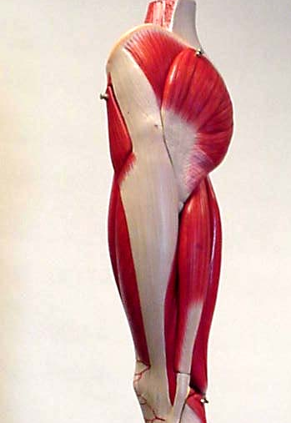
*click to the next slide to check your answer

Slide 42
Gluteus medius
Action: Abduction of the thigh at the hip

Slide 43
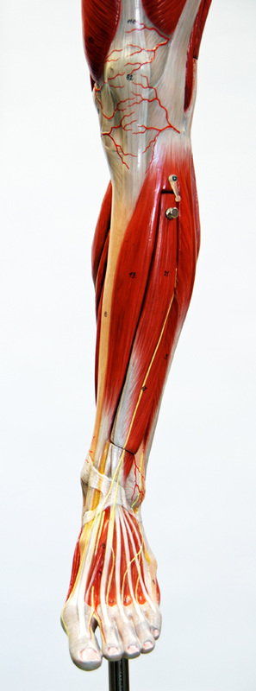
*click to the next slide to check your answer

Slide 44
Extensor digitorum longus
Action: Extension of digits (toes) and dorsiflexion at ankle

Slide 45
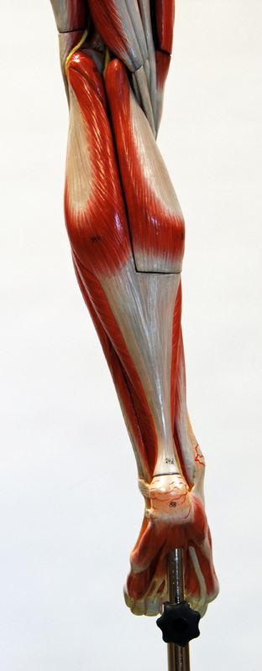
*click to the next slide to check your answer

Slide 46
Gastrocnemius
Action: Plantar flexion at ankle; helps with knee flexion

