Slide 1
Heart Models
Practice Exam #1

Slide 2
Name the following structures indicated by the arrows.
Click to the next slide to see the answer.
*For best results on these practice exams, write your answers on paper before clicking to see the correct answer. Try to answer within a minute (remember your lab exams will be timed) and make sure to check your spelling!
*note: not every structure you are required to know will be on this practice exercise so make sure you review the checklist of structures (p. 194 in your lab manual) when preparing for your lab exam

Slide 3
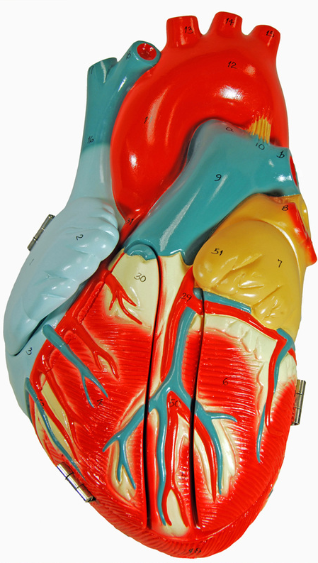
*click to the next slide to check your answer

Slide 4
Ascending aorta

Slide 5
*click to the next slide to check your answer

Slide 6
Ligamentum arteriosum

Slide 7
*click to the next slide to check your answer

Slide 8
Auricle of right atrium

Slide 9
*click to the next slide to check your answer

Slide 10
Apex of heart

Slide 11
*click to the next slide to check your answer

Slide 12
Right coronary artery

Slide 13
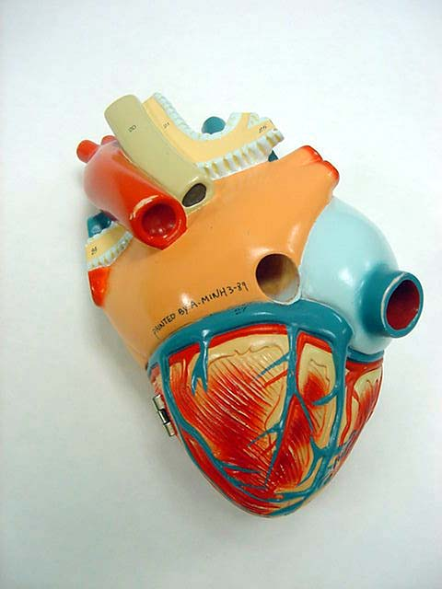
*click to the next slide to check your answer

Slide 14
Left atrium

Slide 15
*click to the next slide to check your answer

Slide 16
Coronary sinus

Slide 17
*click to the next slide to check your answer

Slide 18
Right pulmonary veins

Slide 19
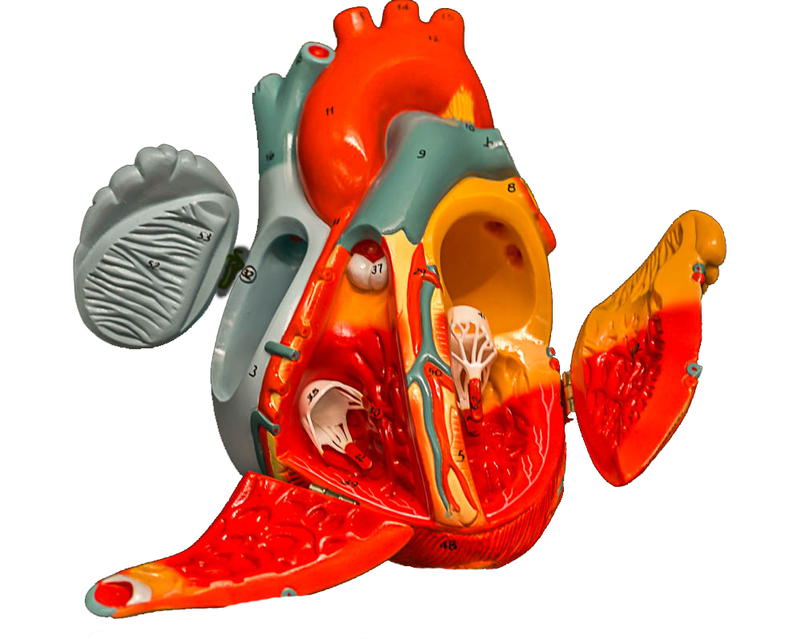
*click to the next slide to check your answer

Slide 20
Pectinate muscles

Slide 21
*click to the next slide to check your answer

Slide 22
Trabeculae carneae (in right ventricle)

Slide 23
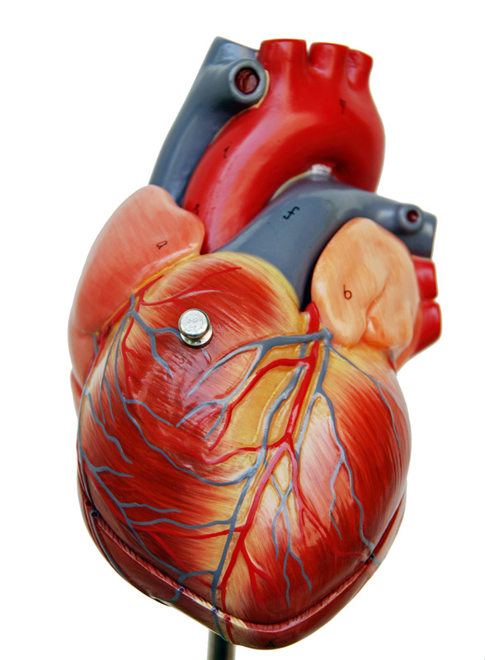
*click to the next slide to check your answer

Slide 24
Brachiocephalic trunk

Slide 25
*click to the next slide to check your answer

Slide 26
Superior vena cava

Slide 27
*click to the next slide to check your answer

Slide 28
Left pulmonary artery

Slide 29
*click to the next slide to check your answer

Slide 30
Anterior interventricular sulcus

Slide 31
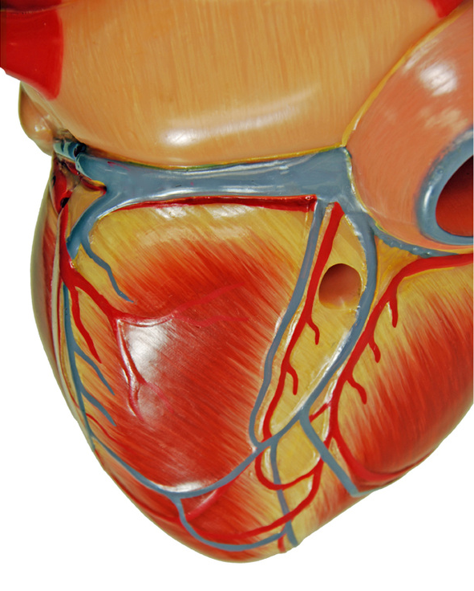
(indentation)
*click to the next slide to check your answer

Slide 32
Coronary sulcus

Slide 33
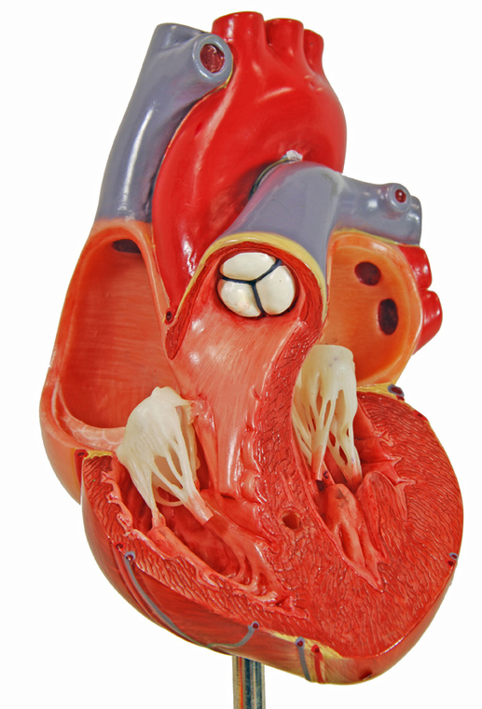
*click to the next slide to check your answer

Slide 34
Pulmonary semilunar valve

Slide 35
*click to the next slide to check your answer

Slide 36
Chordae tendineae of tricuspid valve

Slide 37
*click to the next slide to check your answer

Slide 38
Interventricular septum

Slide 39
*click to the next slide to check your answer

Slide 40
Bicuspid (mitral) valve

Slide 41
*click to the next slide to check your answer

Slide 42
Papillary muscle

Slide 43
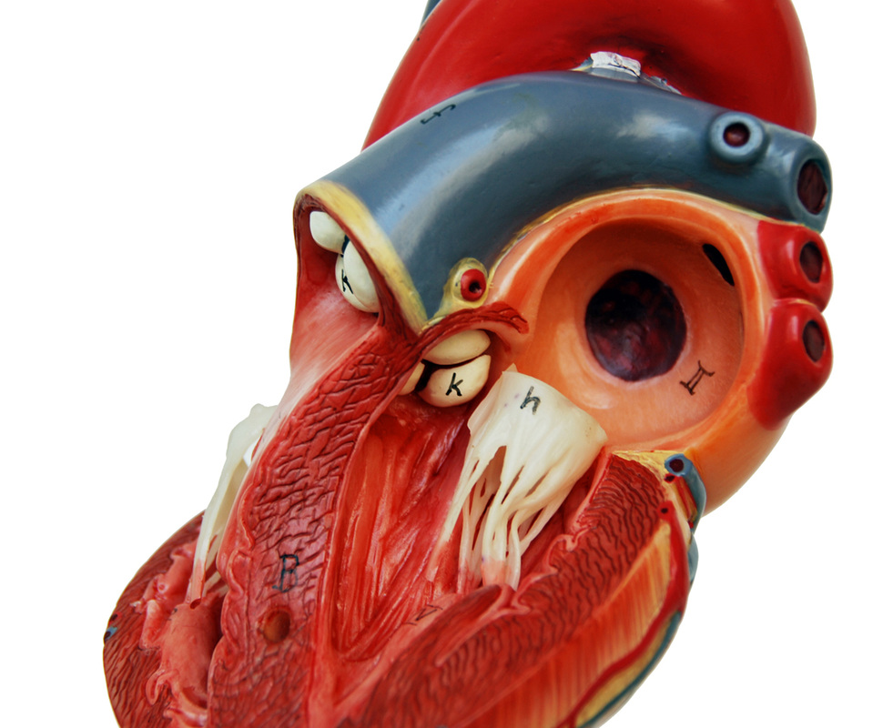
*click to the next slide to check your answer

Slide 44
Aortic semilunar valve

Slide 45
*click to the next slide to check your answer

Slide 46
Epicardium

