Slide 1
Fetal Pig Practice Exam #4

Slide 2
Name the following structures indicated by the arrows.
Click to the next slide to see the answer.
*For best results on these practice exams, write your answers on paper before clicking to see the correct answer. Try to answer within a minute (remember your lab exams will be timed) and make sure to check your spelling!
*note: not every structure you are required to know will be on this practice exercise so make sure you review the checklist of structures (p. 178-179 in your lab manual) when preparing for your lab exam

Slide 3
*click to the next slide to check your answer

Slide 4
facial vein

Slide 5
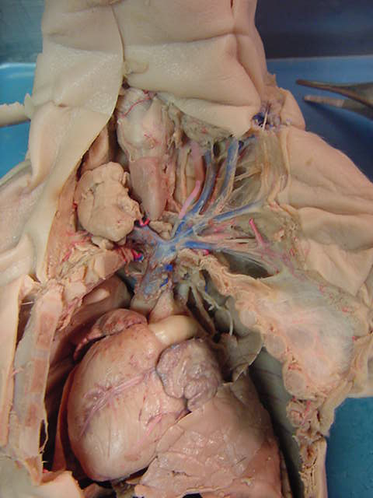
*click to the next slide to check your answer

Slide 6
anterior vena cava

Slide 7
*click to the next slide to check your answer

Slide 8
internal jugular vein

Slide 9
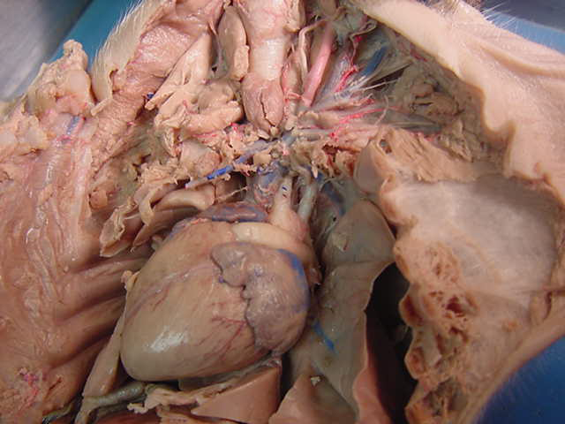
)
*click to the next slide to check your answer

Slide 10
trachea

Slide 11
*click to the next slide to check your answer

Slide 12
pulmonary trunk

Slide 13
*click to the next slide to check your answer

Slide 14
apex of heart

Slide 15
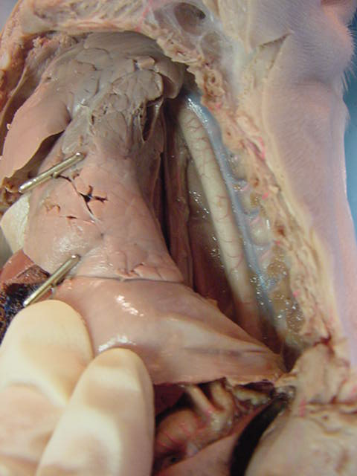
*click to the next slide to check your answer

Slide 16
hemiazygos vein

Slide 17
*click to the next slide to check your answer

Slide 18
intercostal arteries

Slide 19
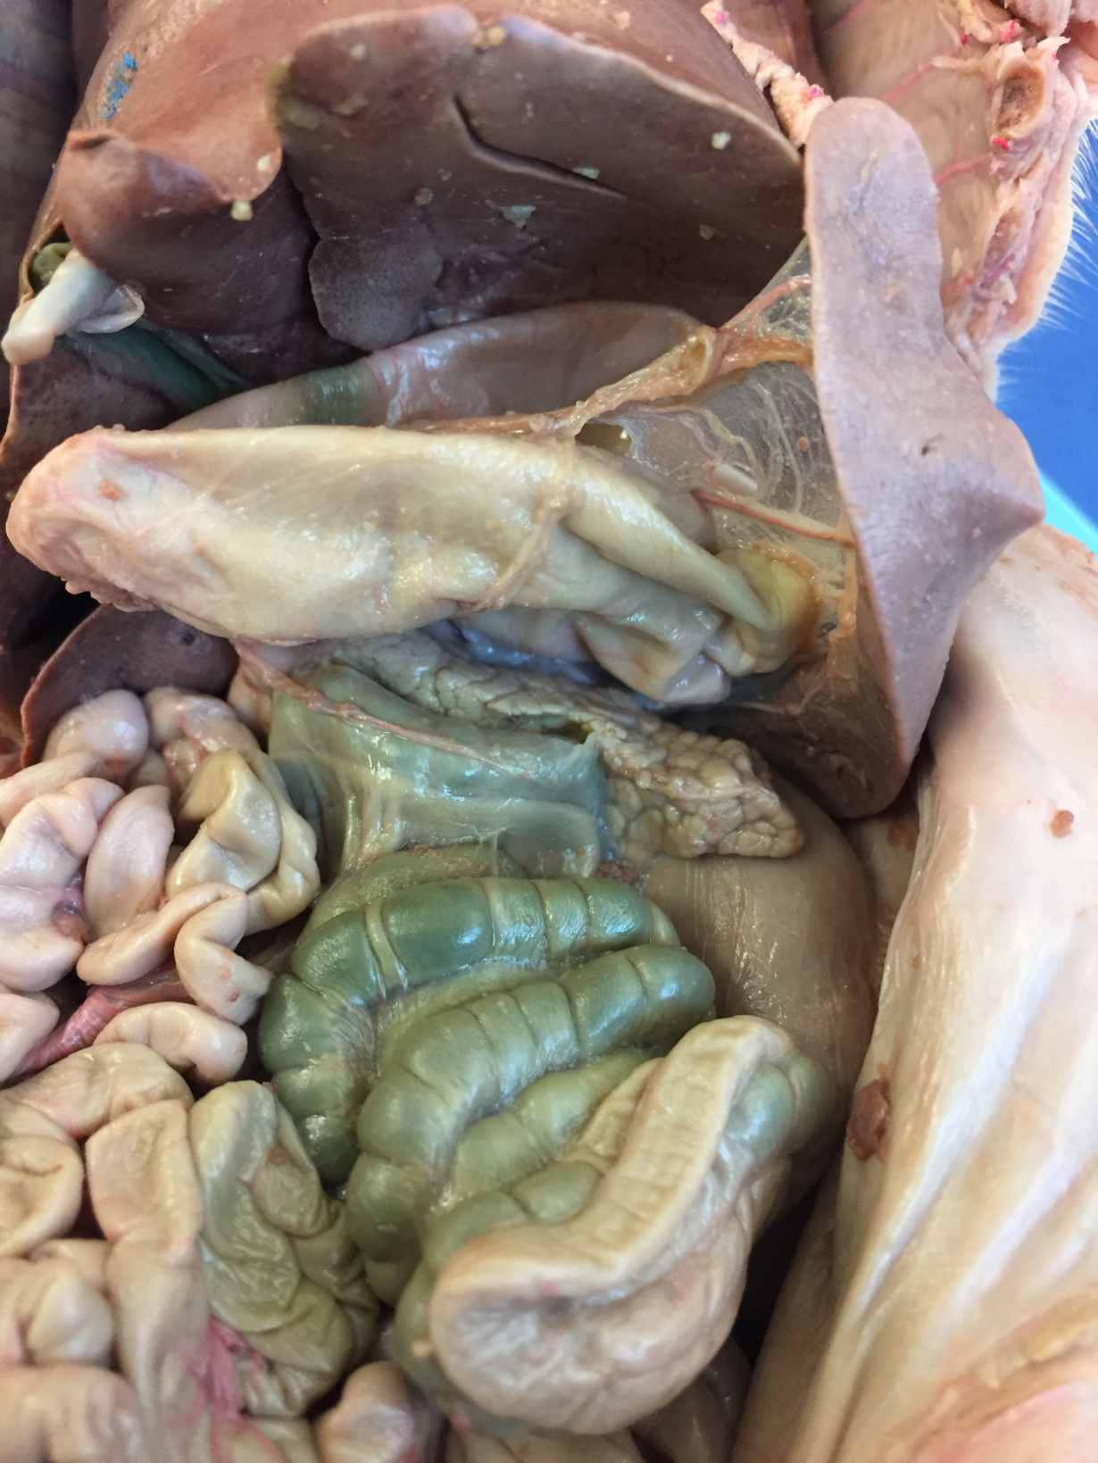
*click to the next slide to check your answer

Slide 20
stomach

Slide 21
*click to the next slide to check your answer

Slide 22
spiral colon

Slide 23
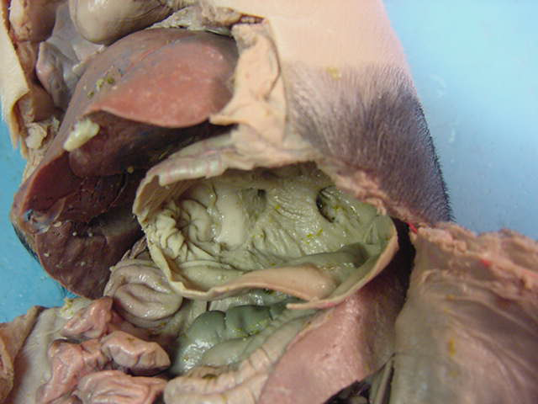
*click to the next slide to check your answer

Slide 24
spleen

Slide 25
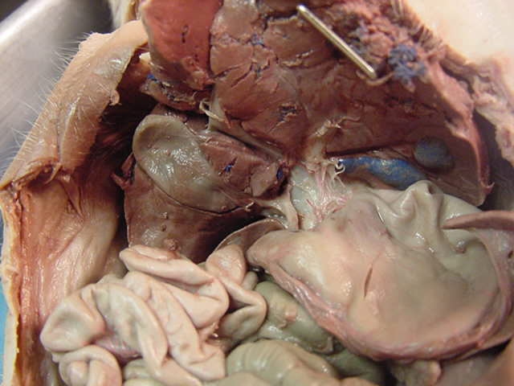
*click to the next slide to check your answer

Slide 26
Hepatic duct

Slide 27
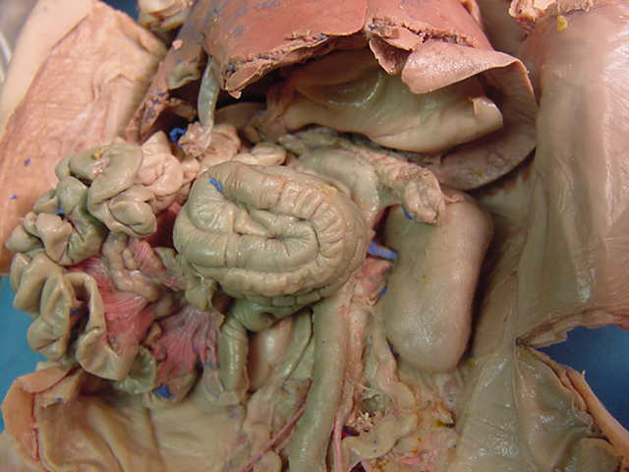
*click to the next slide to check your answer

Slide 28
Mesentery proper

Slide 29
*click to the next slide to check your answer

Slide 30
Pancreas

Slide 31
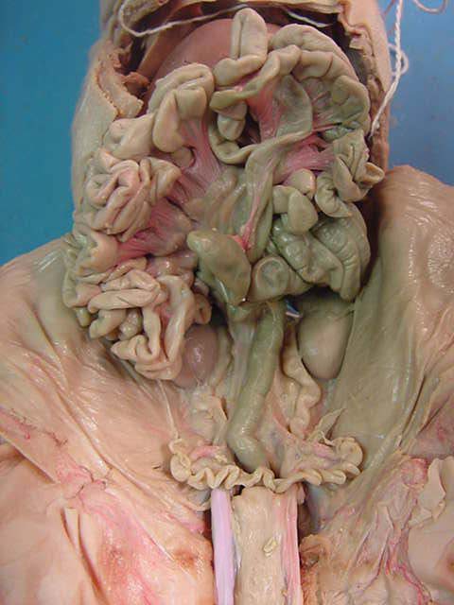
*click to the next slide to check your answer

Slide 32
Ureter

Slide 33
*click to the next slide to check your answer

Slide 34
Umbilical artery

Slide 35
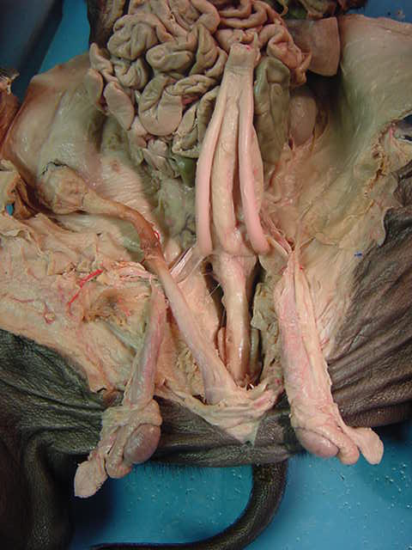
*click to the next slide to check your answer

Slide 36
Urinary bladder

Slide 37
*click to the next slide to check your answer

Slide 38
Epididymis

Slide 39
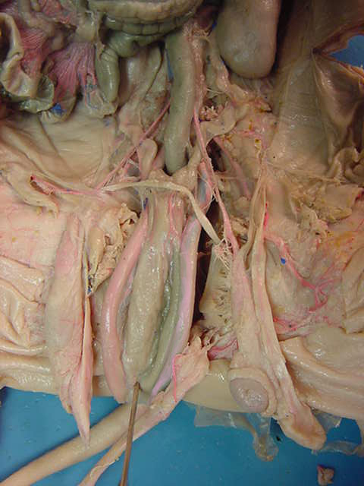
*click to the next slide to check your answer

Slide 40
Vas (ductus) deferens

Slide 41
*click to the next slide to check your answer

Slide 42
Processus vaginallis

Slide 43
*click to the next slide to check your answer

Slide 44
ureter

Slide 45
*click to the next slide to check your answer

Slide 46
uterine horn

Slide 47
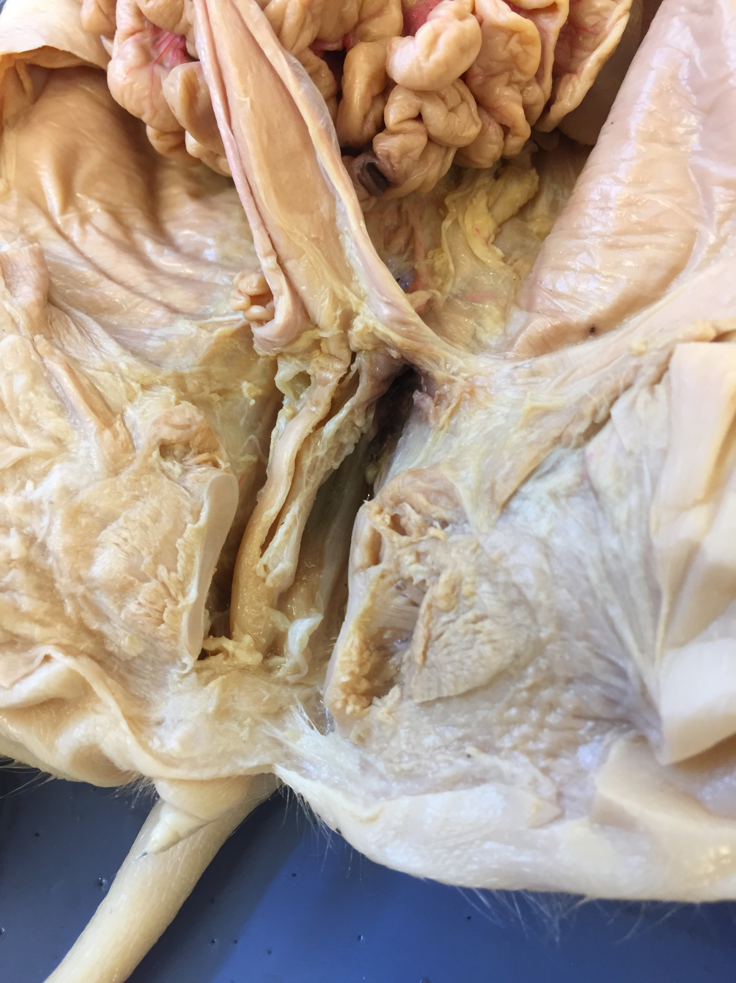
*click to the next slide to check your answer

Slide 48
umbilical arteries

Slide 49
*click to the next slide to check your answer

Slide 50
rectum

