Slide 1
Fetal Pig Practice Exam #3

Slide 2
Name the following structures indicated by the arrows.
Click to the next slide to see the answer.
*For best results on these practice exams, write your answers on paper before clicking to see the correct answer. Try to answer within a minute (remember your lab exams will be timed) and make sure to check your spelling!
*note: not every structure you are required to know will be on this practice exercise so make sure you review the checklist of structures (p. 178-179 in your lab manual) when preparing for your lab exam

Slide 3
*click to the next slide to check your answer

Slide 4
submandibular gland

Slide 5
*click to the next slide to check your answer

Slide 6
epiglottis

Slide 7
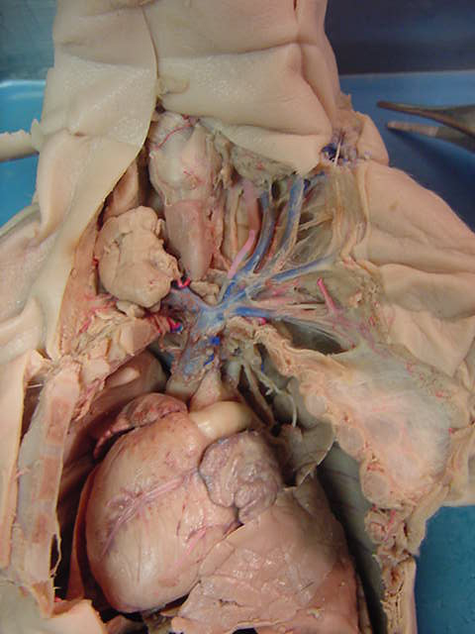
*click to the next slide to check your answer

Slide 8
thymus gland

Slide 9
*click to the next slide to check your answer

Slide 10
common carotid artery

Slide 11
*click to the next slide to check your answer

Slide 12
subclavian vein

Slide 13
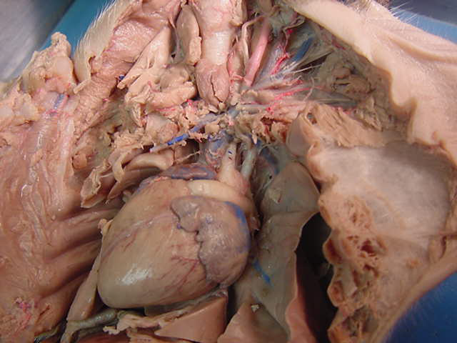
*click to the next slide to check your answer

Slide 14
left subclavian artery

Slide 15
*click to the next slide to check your answer

Slide 16
auricle of right atrium

Slide 17
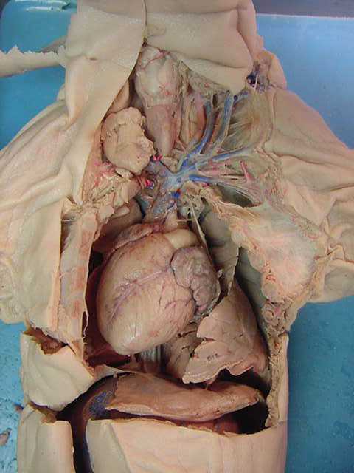
*click to the next slide to check your answer

Slide 18
diaphragm

Slide 19
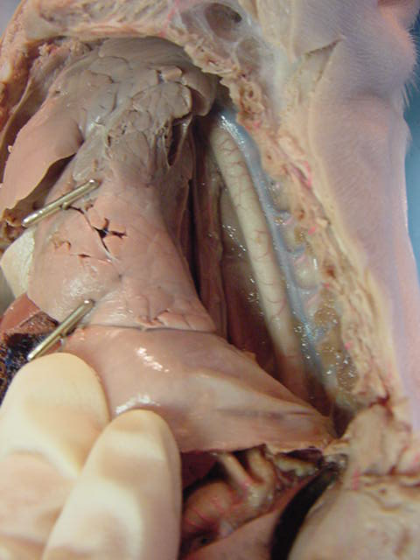
*click to the next slide to check your answer

Slide 20
intercostal vein

Slide 21
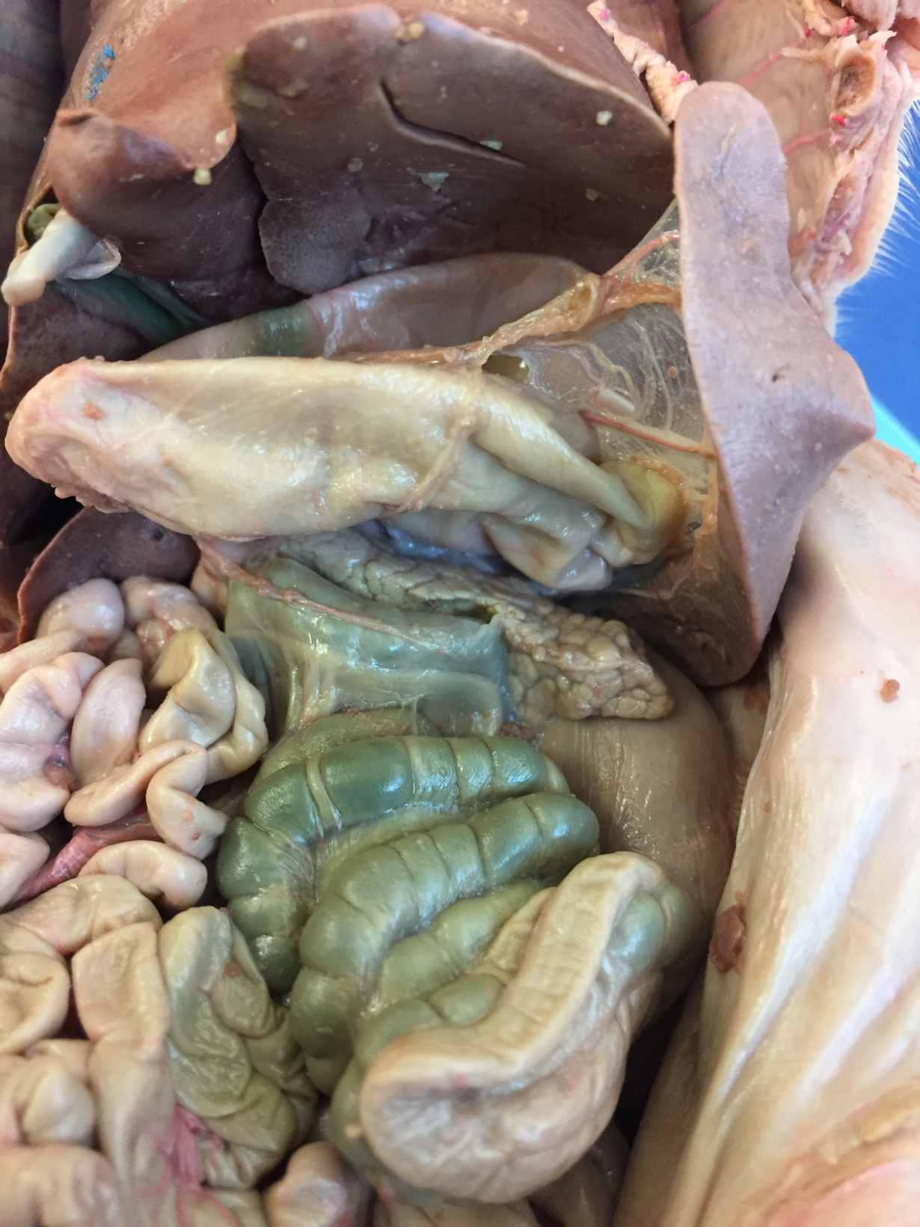
*click to the next slide to check your answer

Slide 22
gall bladder

Slide 23
*click to the next slide to check your answer

Slide 24
pancreas

Slide 25
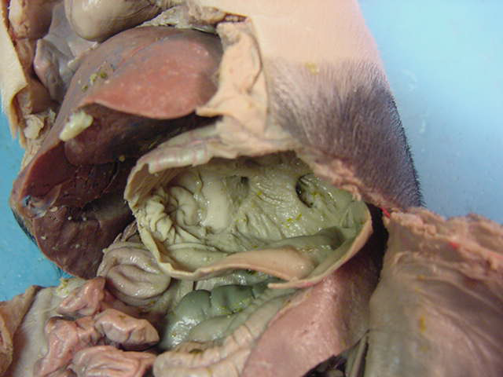
*click to the next slide to check your answer

Slide 26
Diverticulum ventriculi

Slide 27
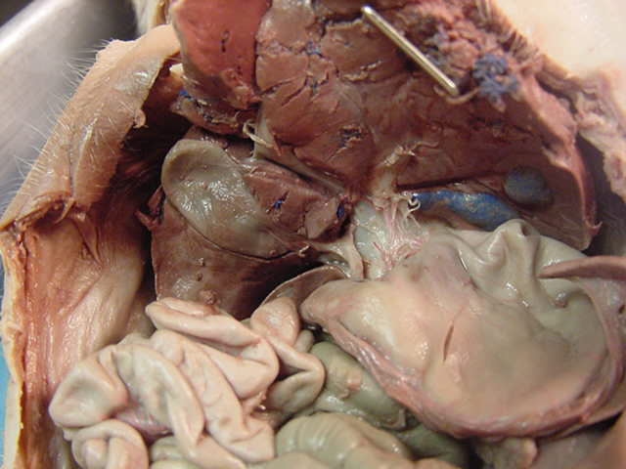
*click to the next slide to check your answer

Slide 28
Common bile duct

Slide 29
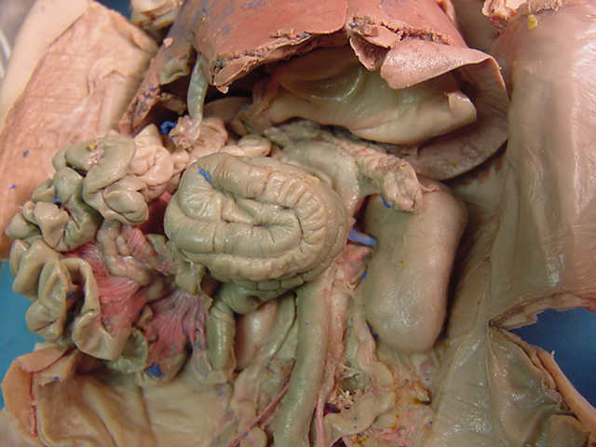
*click to the next slide to check your answer

Slide 30
Mesenteric lymph nodes

Slide 31
*click to the next slide to check your answer

Slide 32
rectum

Slide 33
*click to the next slide to check your answer

Slide 34
Kidney

Slide 35
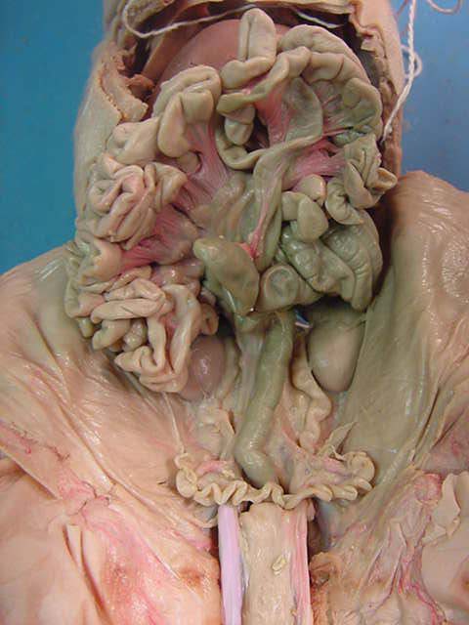
*click to the next slide to check your answer

Slide 36
Cecum

Slide 37
*click to the next slide to check your answer

Slide 38
Uterine horn

Slide 39
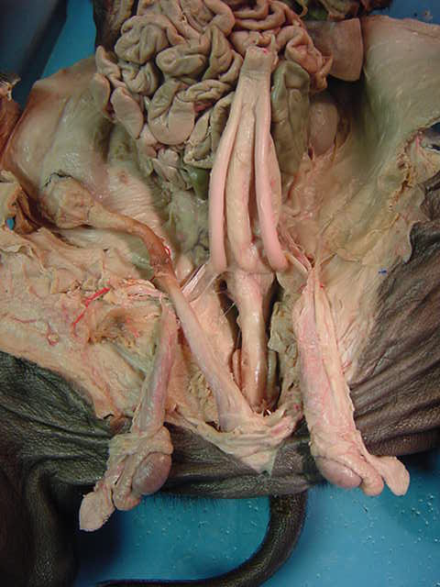
*click to the next slide to check your answer

Slide 40
Penis

Slide 41
*click to the next slide to check your answer

Slide 42
Bulbourethral (Cowper’s) Gland

Slide 43
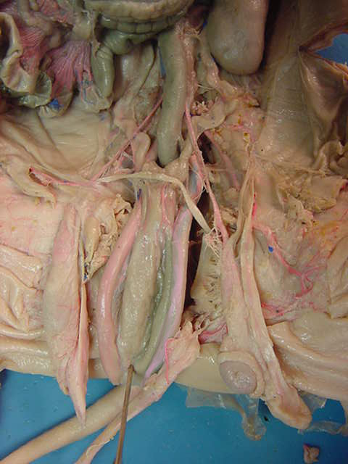
*click to the next slide to check your answer

Slide 44
Testicular arteries

Slide 45
*click to the next slide to check your answer

Slide 46
Epididymis

Slide 47
*click to the next slide to check your answer

Slide 48
renal artery

Slide 49
*click to the next slide to check your answer

Slide 50
ovary

Slide 51
*click to the next slide to check your answer

Slide 52
urinary bladder

Slide 53
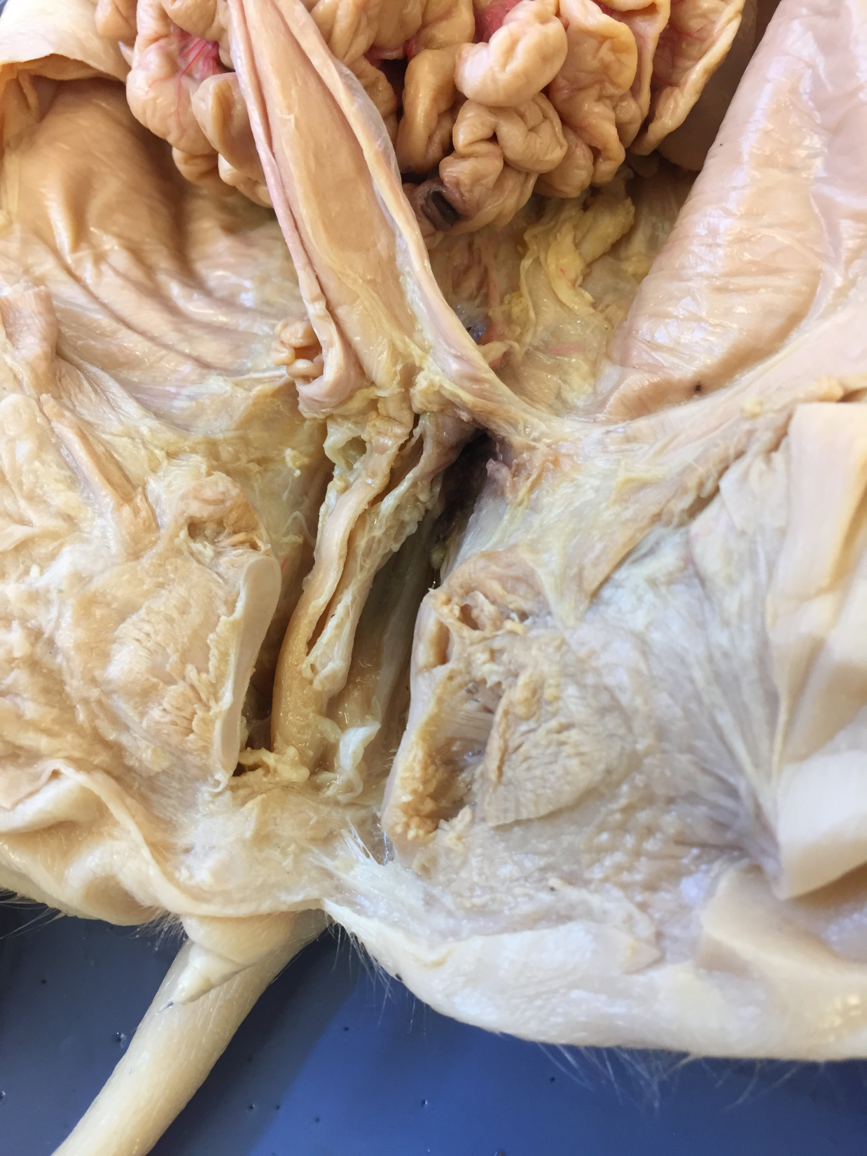
*click to the next slide to check your answer

Slide 54
vagina

Slide 55
*click to the next slide to check your answer

Slide 56
genital papilla

