Slide 1
Fetal Pig Practice Exam #2

Slide 2
Name the following structures indicated by the arrows.
Click to the next slide to see the answer.
*For best results on these practice exams, write your answers on paper before clicking to see the correct answer. Try to answer within a minute (remember your lab exams will be timed) and make sure to check your spelling!
*note: not every structure you are required to know will be on this practice exercise so make sure you review the checklist of structures (p. 178-179 in your lab manual) when preparing for your lab exam

Slide 3
*click to the next slide to check your answer

Slide 4
masseter

Slide 5
*click to the next slide to check your answer

Slide 6
soft palate

Slide 7
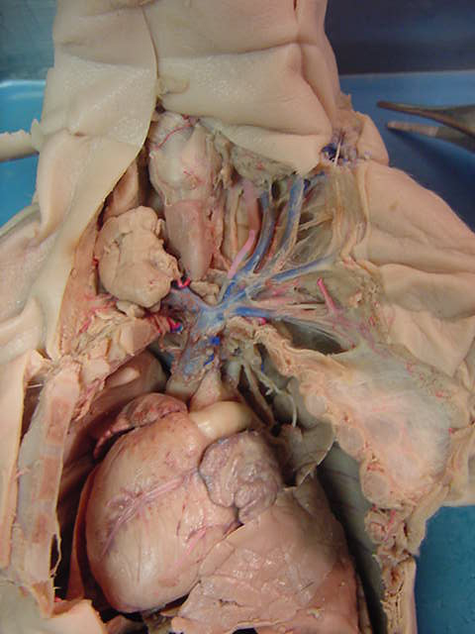
*click to the next slide to check your answer

Slide 8
thyroid gland

Slide 9
*click to the next slide to check your answer

Slide 10
vagus nerve

Slide 11
*click to the next slide to check your answer

Slide 12
subscapular vein

Slide 13
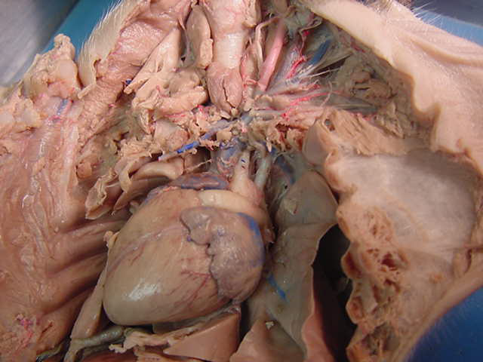
*click to the next slide to check your answer

Slide 14
aortic arch

Slide 15
*click to the next slide to check your answer

Slide 16
left lung

Slide 17
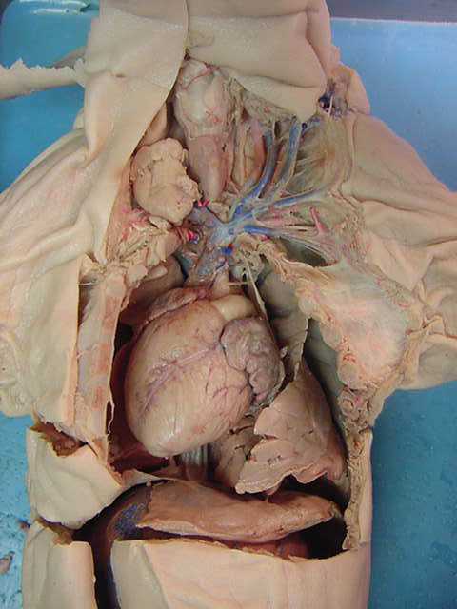
*click to the next slide to check your answer

Slide 18
Posterior vena cava

Slide 19
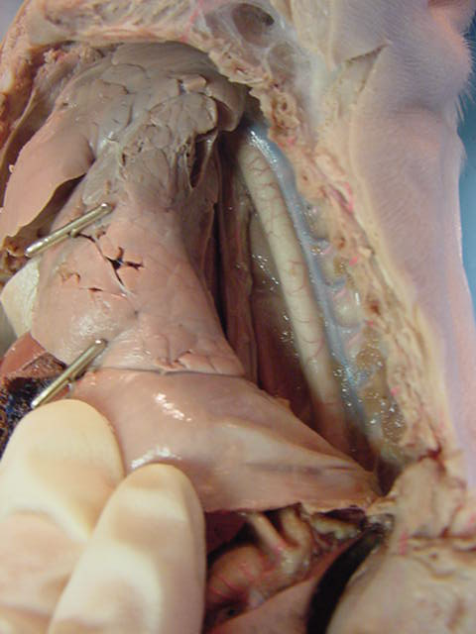
*click to the next slide to check your answer

Slide 20
esophagus

Slide 21
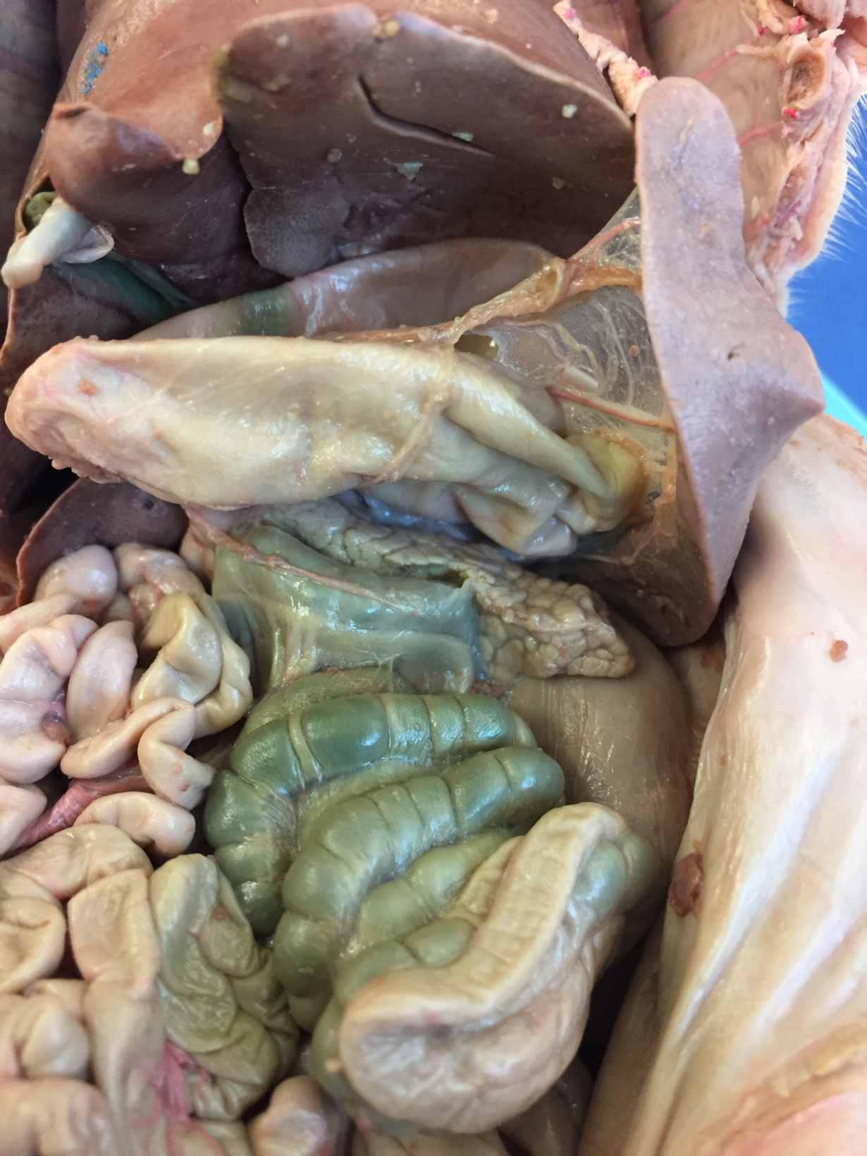
*click to the next slide to check your answer

Slide 22
umbilical vein

Slide 23
*click to the next slide to check your answer

Slide 24
spleen

Slide 25
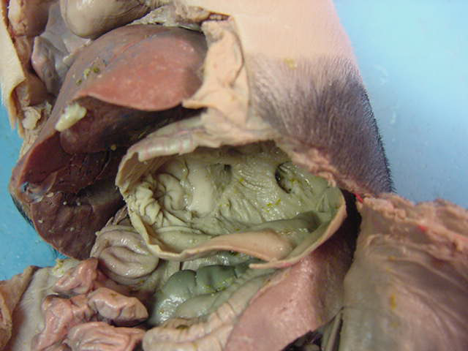
*click to the next slide to check your answer

Slide 26
Cardiac sphincter

Slide 27
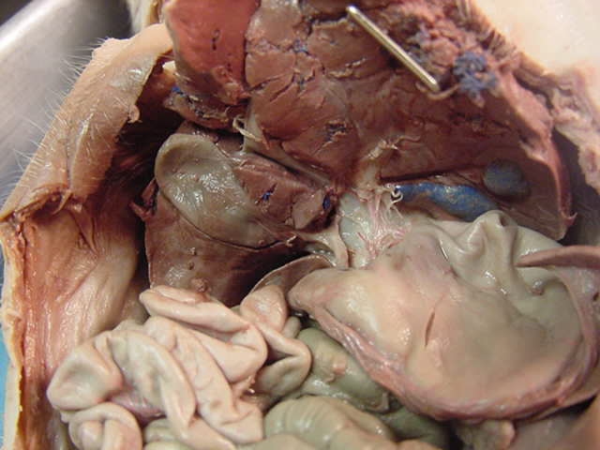
*click to the next slide to check your answer

Slide 28
Cystic duct

Slide 29
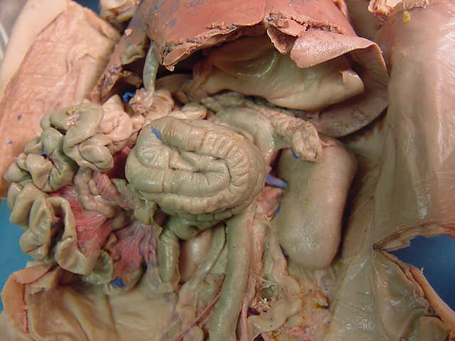
*click to the next slide to check your answer

Slide 30
Spiral colon

Slide 31
*click to the next slide to check your answer

Slide 32
cecum

Slide 33
*click to the next slide to check your answer

Slide 34
Renal artery

Slide 35
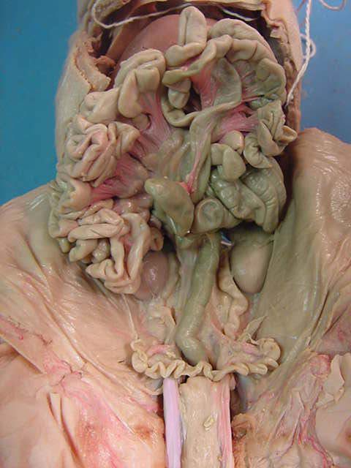
*click to the next slide to check your answer

Slide 36
Mesenteric lymph nodes

Slide 37
*click to the next slide to check your answer

Slide 38
Ovary

Slide 39
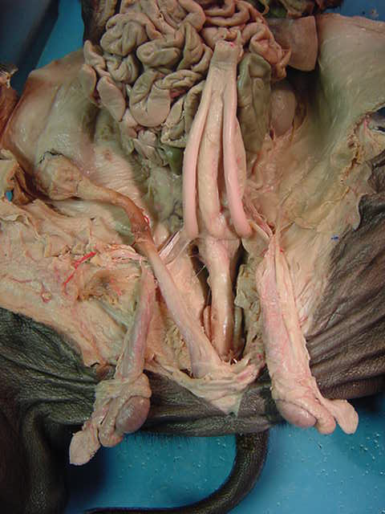
*click to the next slide to check your answer

Slide 40
Glans penis

Slide 41
*click to the next slide to check your answer

Slide 42
Urethra

Slide 43
*click to the next slide to check your answer

Slide 44
Testis

Slide 45
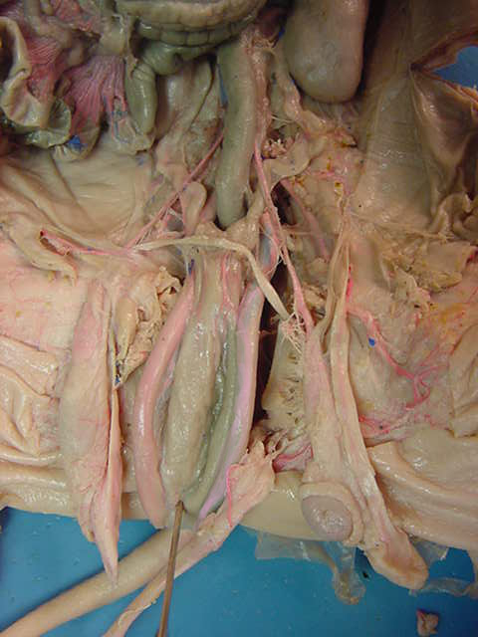
*click to the next slide to check your answer

Slide 46
Urinary bladder

Slide 47
*click to the next slide to check your answer

Slide 48
renal vein

Slide 49
*click to the next slide to check your answer

Slide 50
Fallopian tube

Slide 51
*click to the next slide to check your answer

Slide 52
umbilical artery

Slide 53
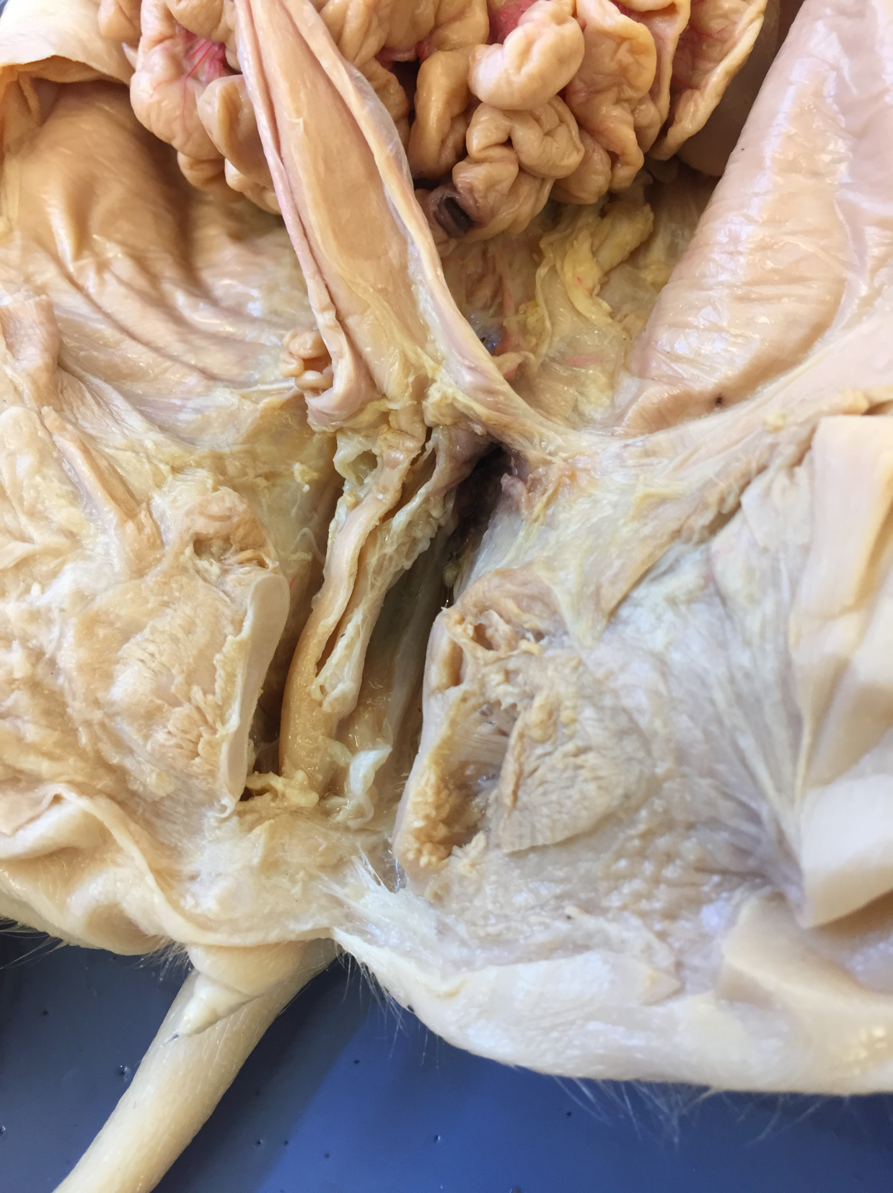
*click to the next slide to check your answer

Slide 54
urethra

Slide 55
*click to the next slide to check your answer

Slide 56
labia

