Slide 1
Fetal Pig Practice Exam #1

Slide 2
Name the following structures indicated by the arrows.
Click to the next slide to see the answer.
*For best results on these practice exams, write your answers on paper before clicking to see the correct answer. Try to answer within a minute (remember your lab exams will be timed) and make sure to check your spelling!
*note: not every structure you are required to know will be on this practice exercise so make sure you review the checklist of structures (p. 178-179 in your lab manual) when preparing for your lab exam

Slide 3
*click to the next slide to check your answer

Slide 4
facial nerve

Slide 5
*click to the next slide to check your answer

Slide 6
hard palate

Slide 7
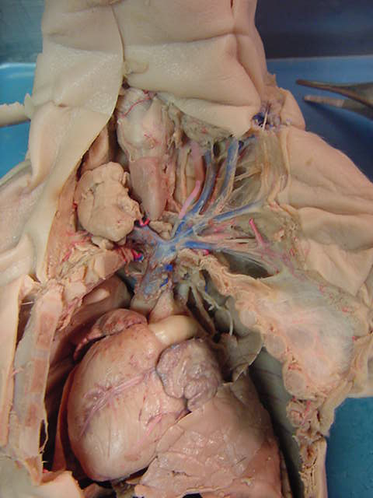
*click to the next slide to check your answer

Slide 8
larynx

Slide 9
*click to the next slide to check your answer

Slide 10
brachiocephalic veins

Slide 11
*click to the next slide to check your answer

Slide 12
external jugular vein

Slide 13
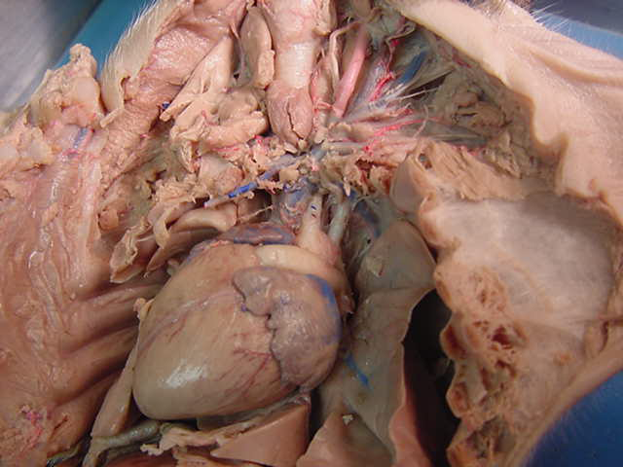
*click to the next slide to check your answer

Slide 14
brachiocephalic trunk (artery)

Slide 15
*click to the next slide to check your answer

Slide 16
auricle of left atrium

Slide 17
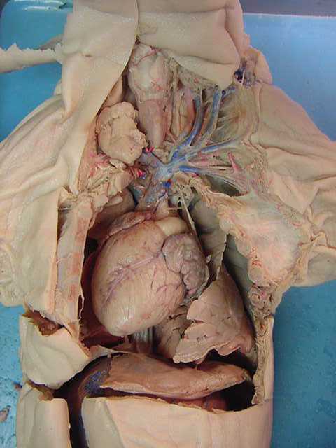
*click to the next slide to check your answer

Slide 18
Phrenic nerve

Slide 19
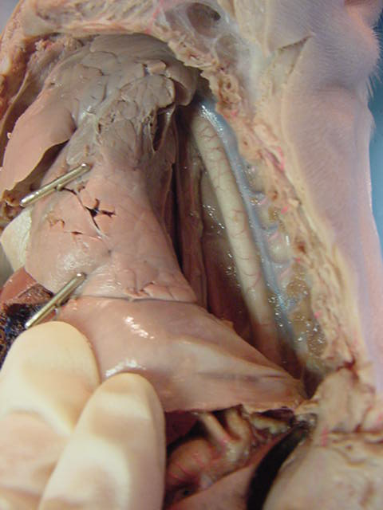
*click to the next slide to check your answer

Slide 20
descending aorta

Slide 21
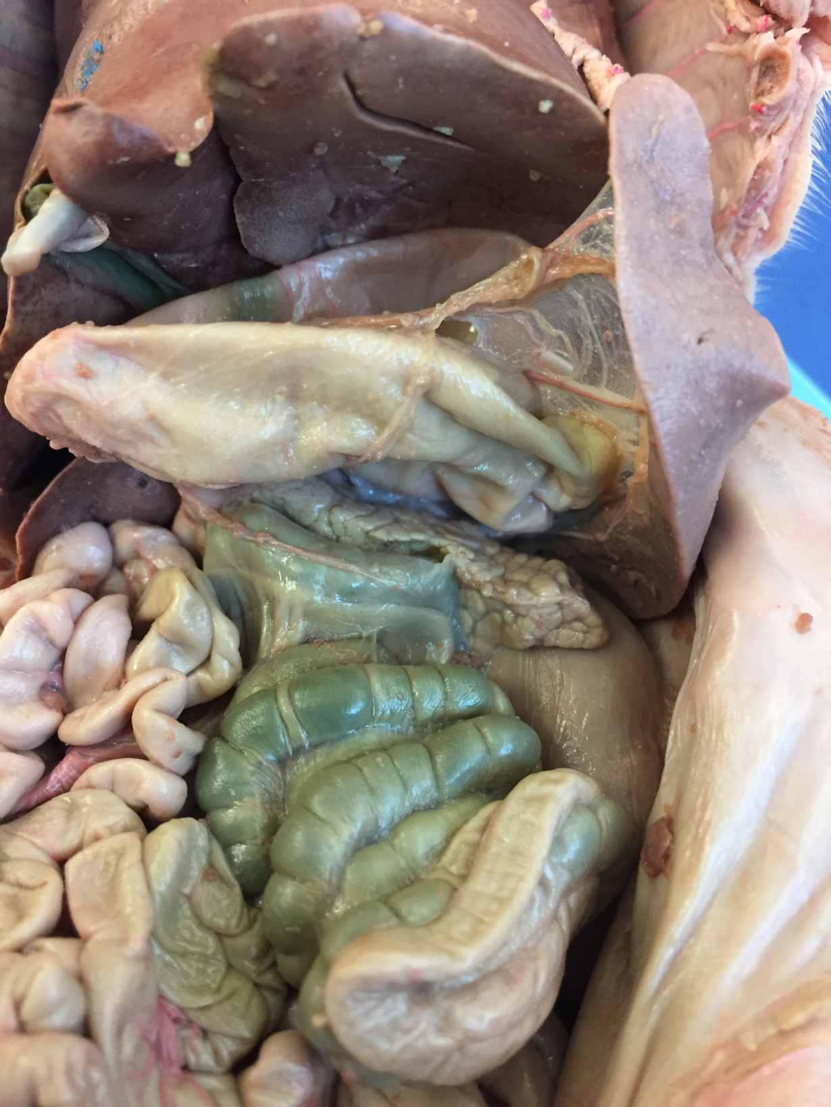
*click to the next slide to check your answer

Slide 22
liver

Slide 23
*click to the next slide to check your answer

Slide 24
greater omentum

Slide 25
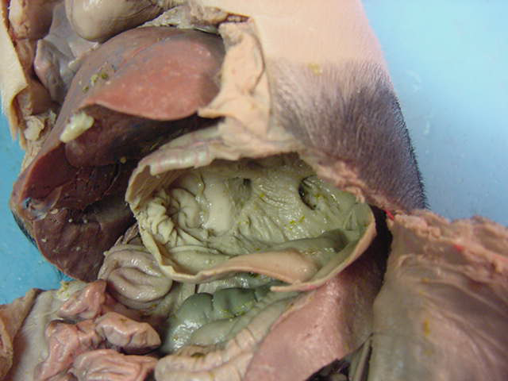
*click to the next slide to check your answer

Slide 26
Pyloric sphincter

Slide 27
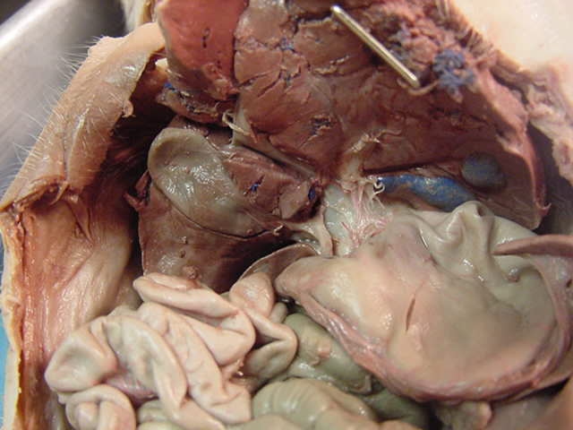
*click to the next slide to check your answer

Slide 28
Gall bladder

Slide 29
*click to the next slide to check your answer

Slide 30
Lesser omentum

Slide 31
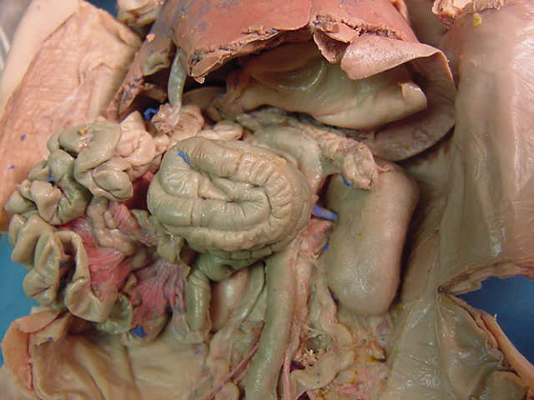
*click to the next slide to check your answer

Slide 32
ileum

Slide 33
*click to the next slide to check your answer

Slide 34
Renal vein

Slide 35
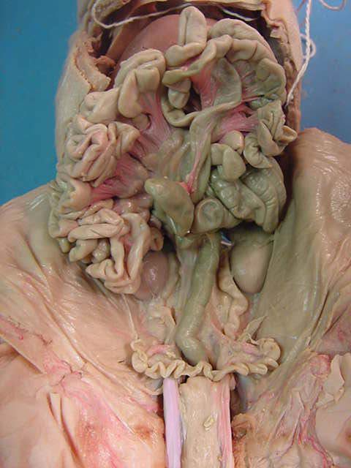
*click to the next slide to check your answer

Slide 36
Mesentery proper

Slide 37
*click to the next slide to check your answer

Slide 38
Fallopian tube

Slide 39
*click to the next slide to check your answer

Slide 40
Urinary bladder

Slide 41
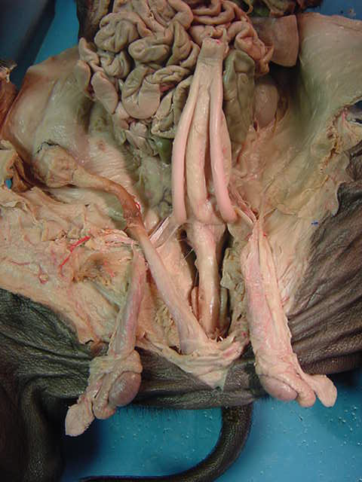
*click to the next slide to check your answer

Slide 42
Umbilical artery

Slide 43
*click to the next slide to check your answer

Slide 44
Processus vaginalis

Slide 45
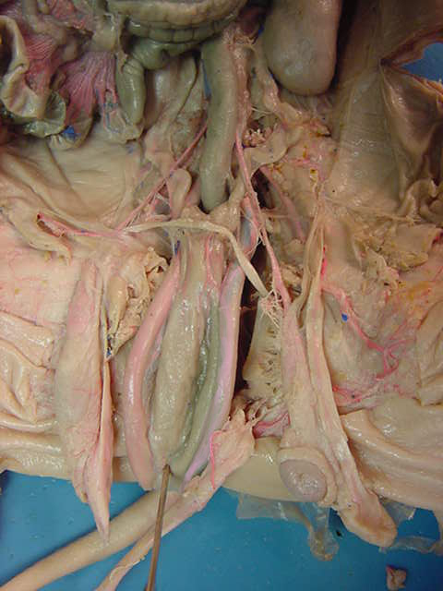
*click to the next slide to check your answer

Slide 46
Testis

Slide 47
*click to the next slide to check your answer

Slide 48
ovarian artery

Slide 49
*click to the next slide to check your answer

Slide 50
uterine body

Slide 51
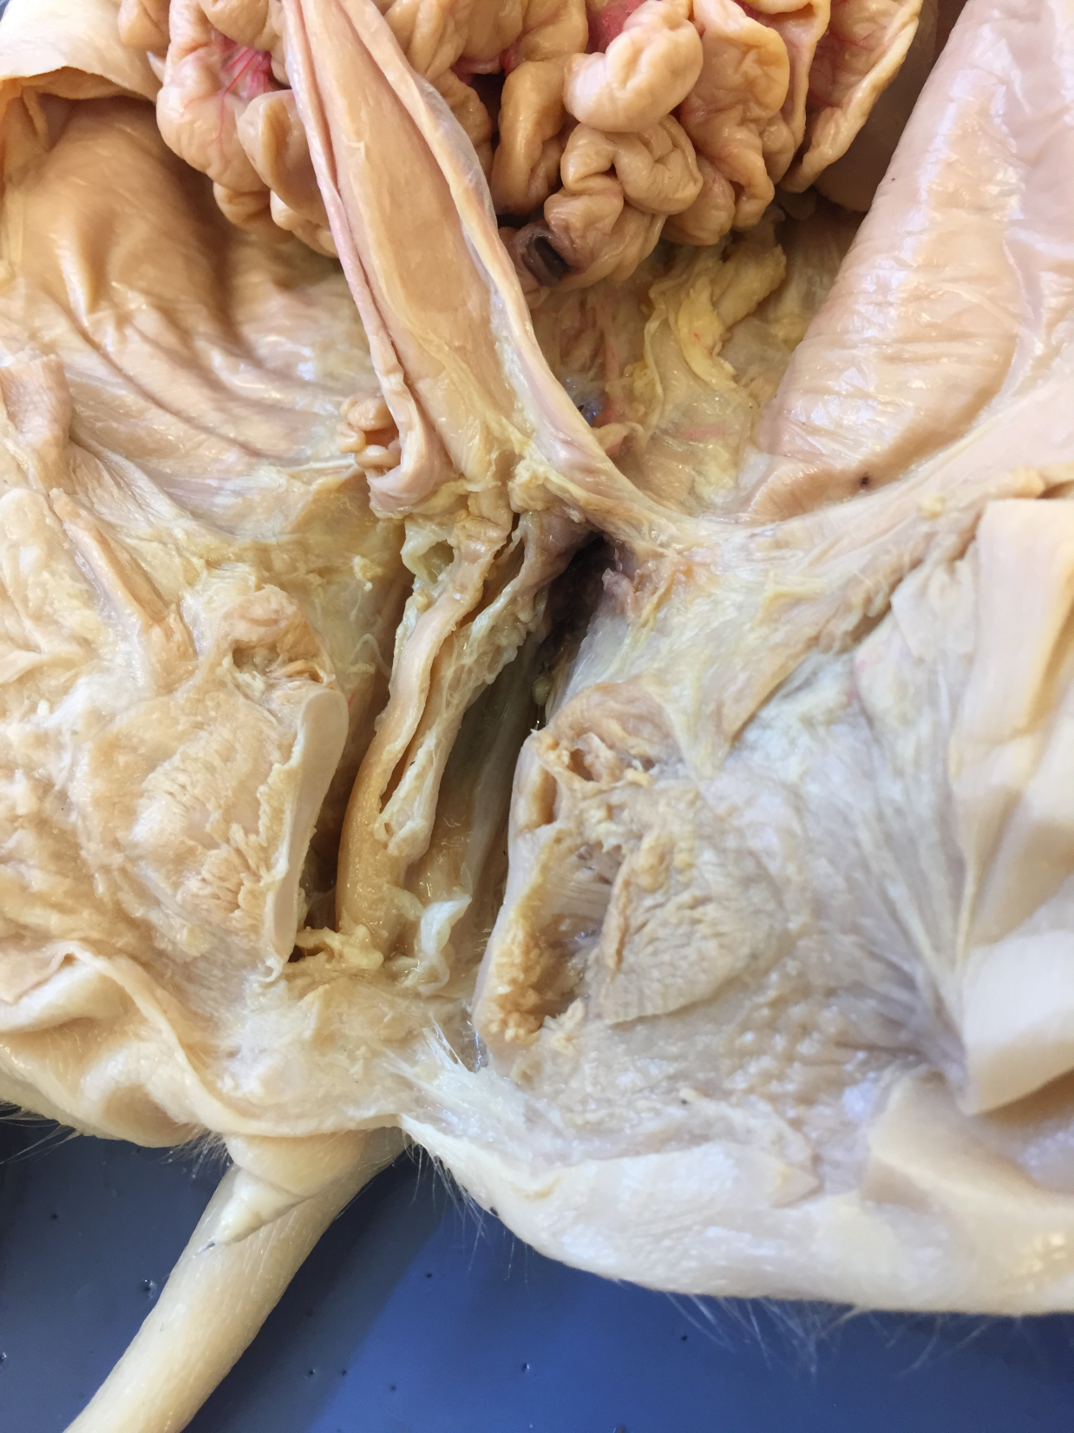
*click to the next slide to check your answer

Slide 52
urinary bladder

Slide 53
*click to the next slide to check your answer

Slide 54
urogenital sinus

