Slide 1
Bone
Practice Exam #1

Slide 2
Name the following structures indicated by the arrows.
Click to the next slide to see the answer.
*For best results on these practice exams, write your answers on paper before clicking to see the correct answer. Try to answer within a minute (remember your lab exams will be timed) and make sure to check your spelling!
*note: not every structure you are required to know will be on this practice exercise so make sure you review the checklist of structures (p. 74-75 in your lab manual) when preparing for your lab exam

Slide 3
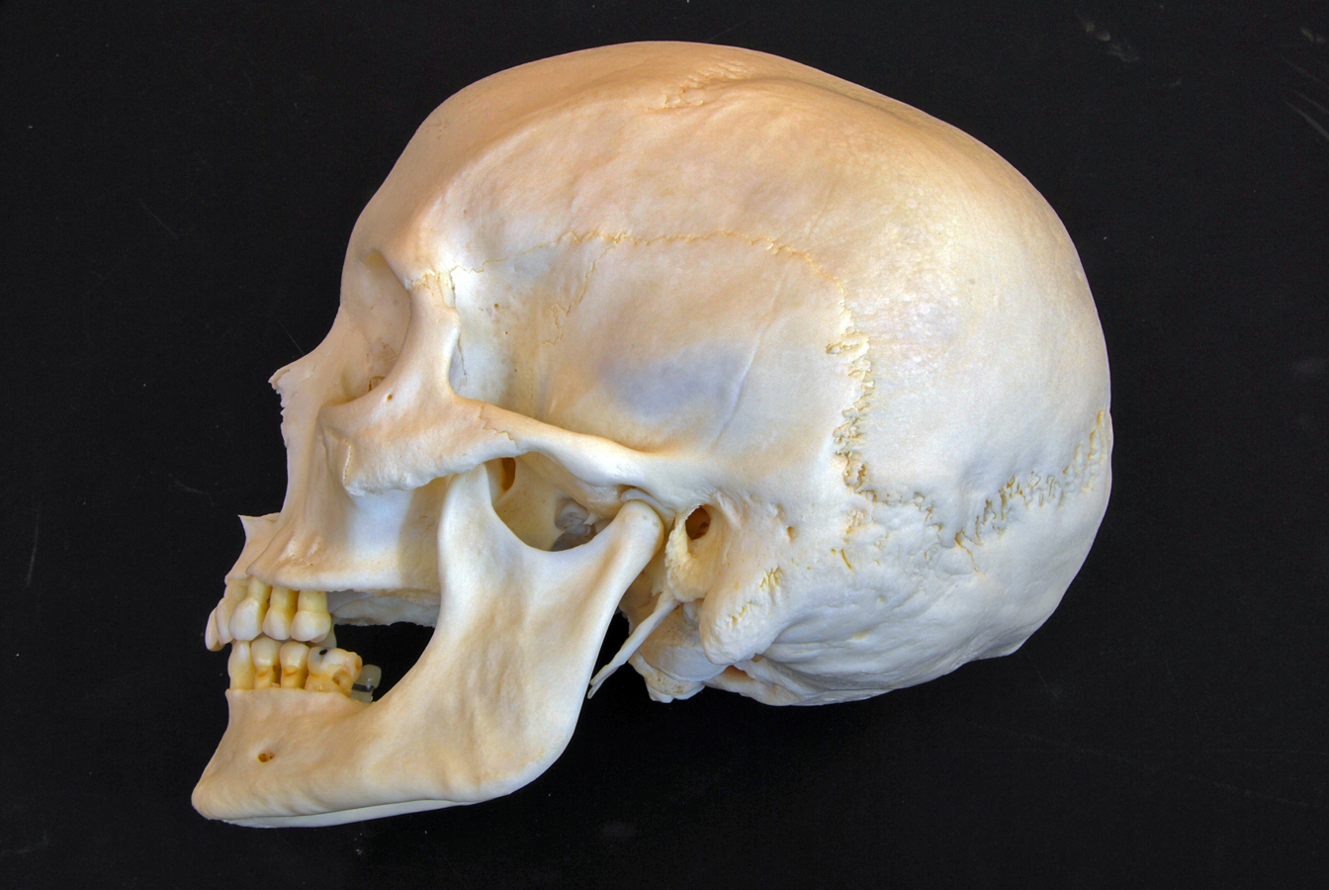
*click to the next slide to check your answer

Slide 4
Squamous suture

Slide 5
*click to the next slide to check your answer

Slide 6
Lacrimal bone

Slide 7
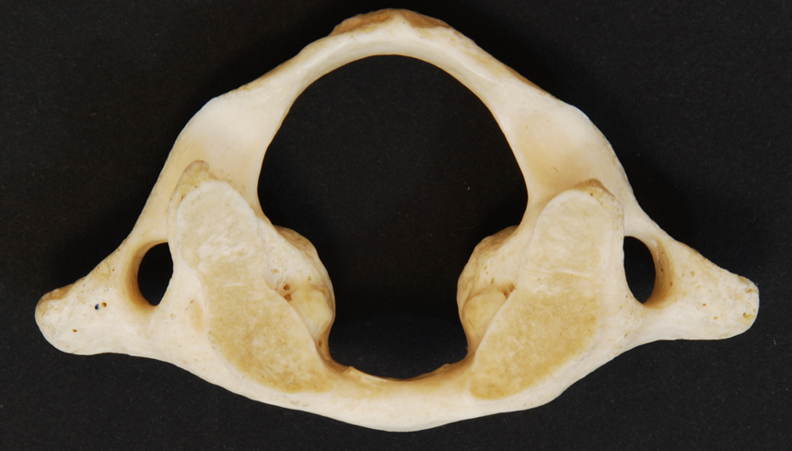
*click to the next slide to check your answer

Slide 8
Vertebral foramen of C1

Slide 9
*click to the next slide to check your answer

Slide 10
Zygomatic process of the temporal bone

Slide 11
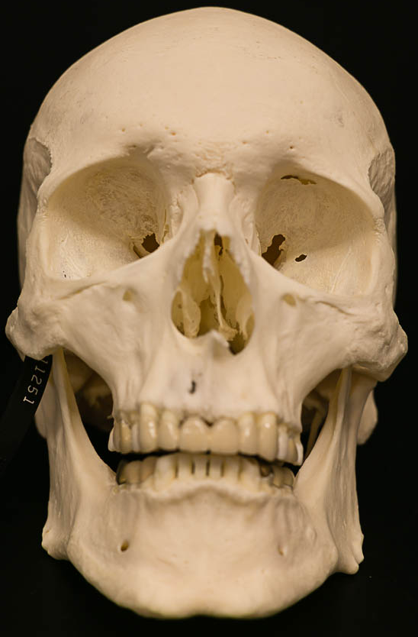
*click to the next slide to check your answer

Slide 12
Inferior nasal conchae

Slide 13
*click to the next slide to check your answer

Slide 14
Perpendicular plate of the ethmoid

Slide 15
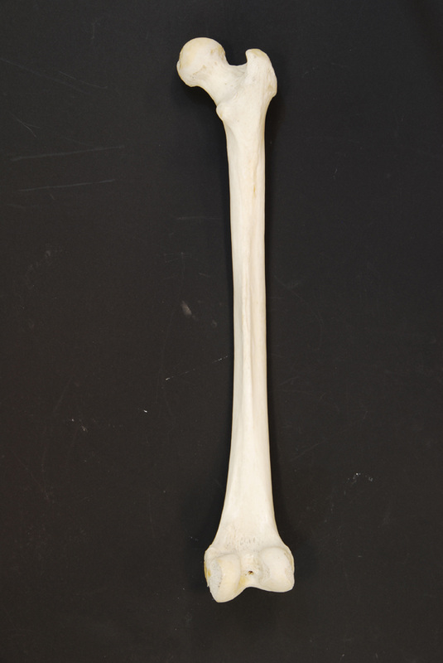
*click to the next slide to check your answer

Slide 16
Lateral condyle of femur

Slide 17
*click to the next slide to check your answer

Slide 18
Nasal bone

Slide 19
*click to the next slide to check your answer

Slide 20
Transverse foramen of a typical cervical

Slide 21
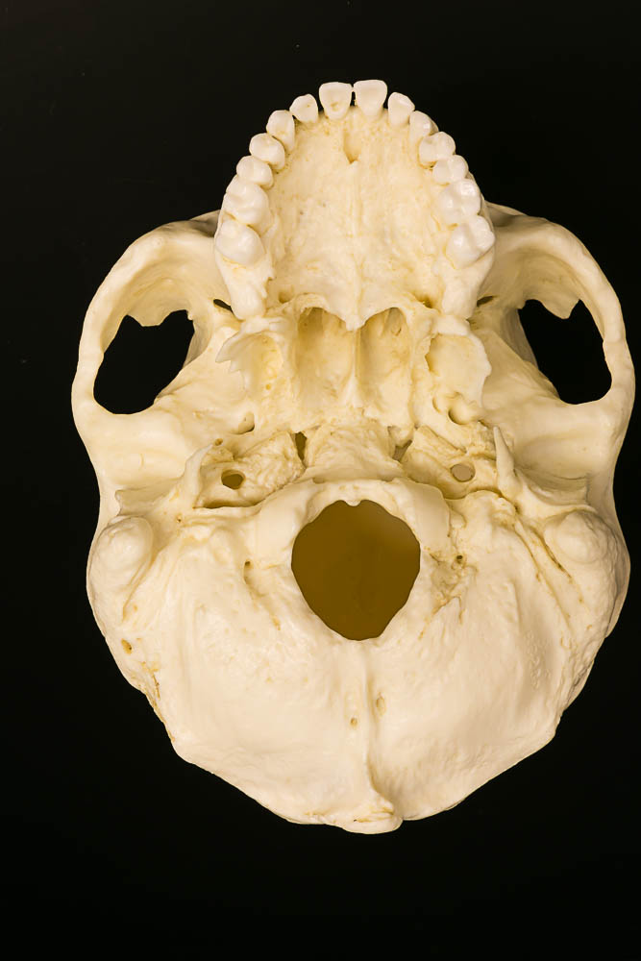
*click to the next slide to check your answer

Slide 22
Palatine process of the maxilla

Slide 23
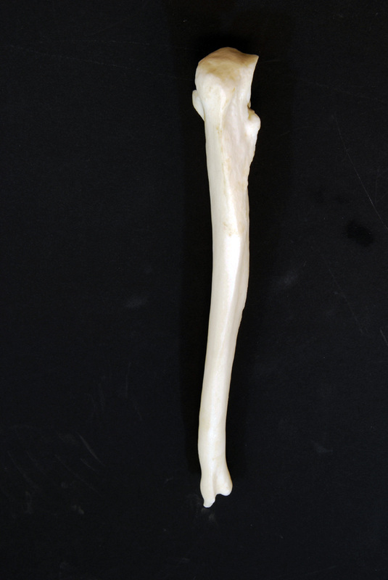
*click to the next slide to check your answer

Slide 24
Styloid process of ulna

Slide 25
*click to the next slide to check your answer

Slide 26
Occipital condyles

Slide 27
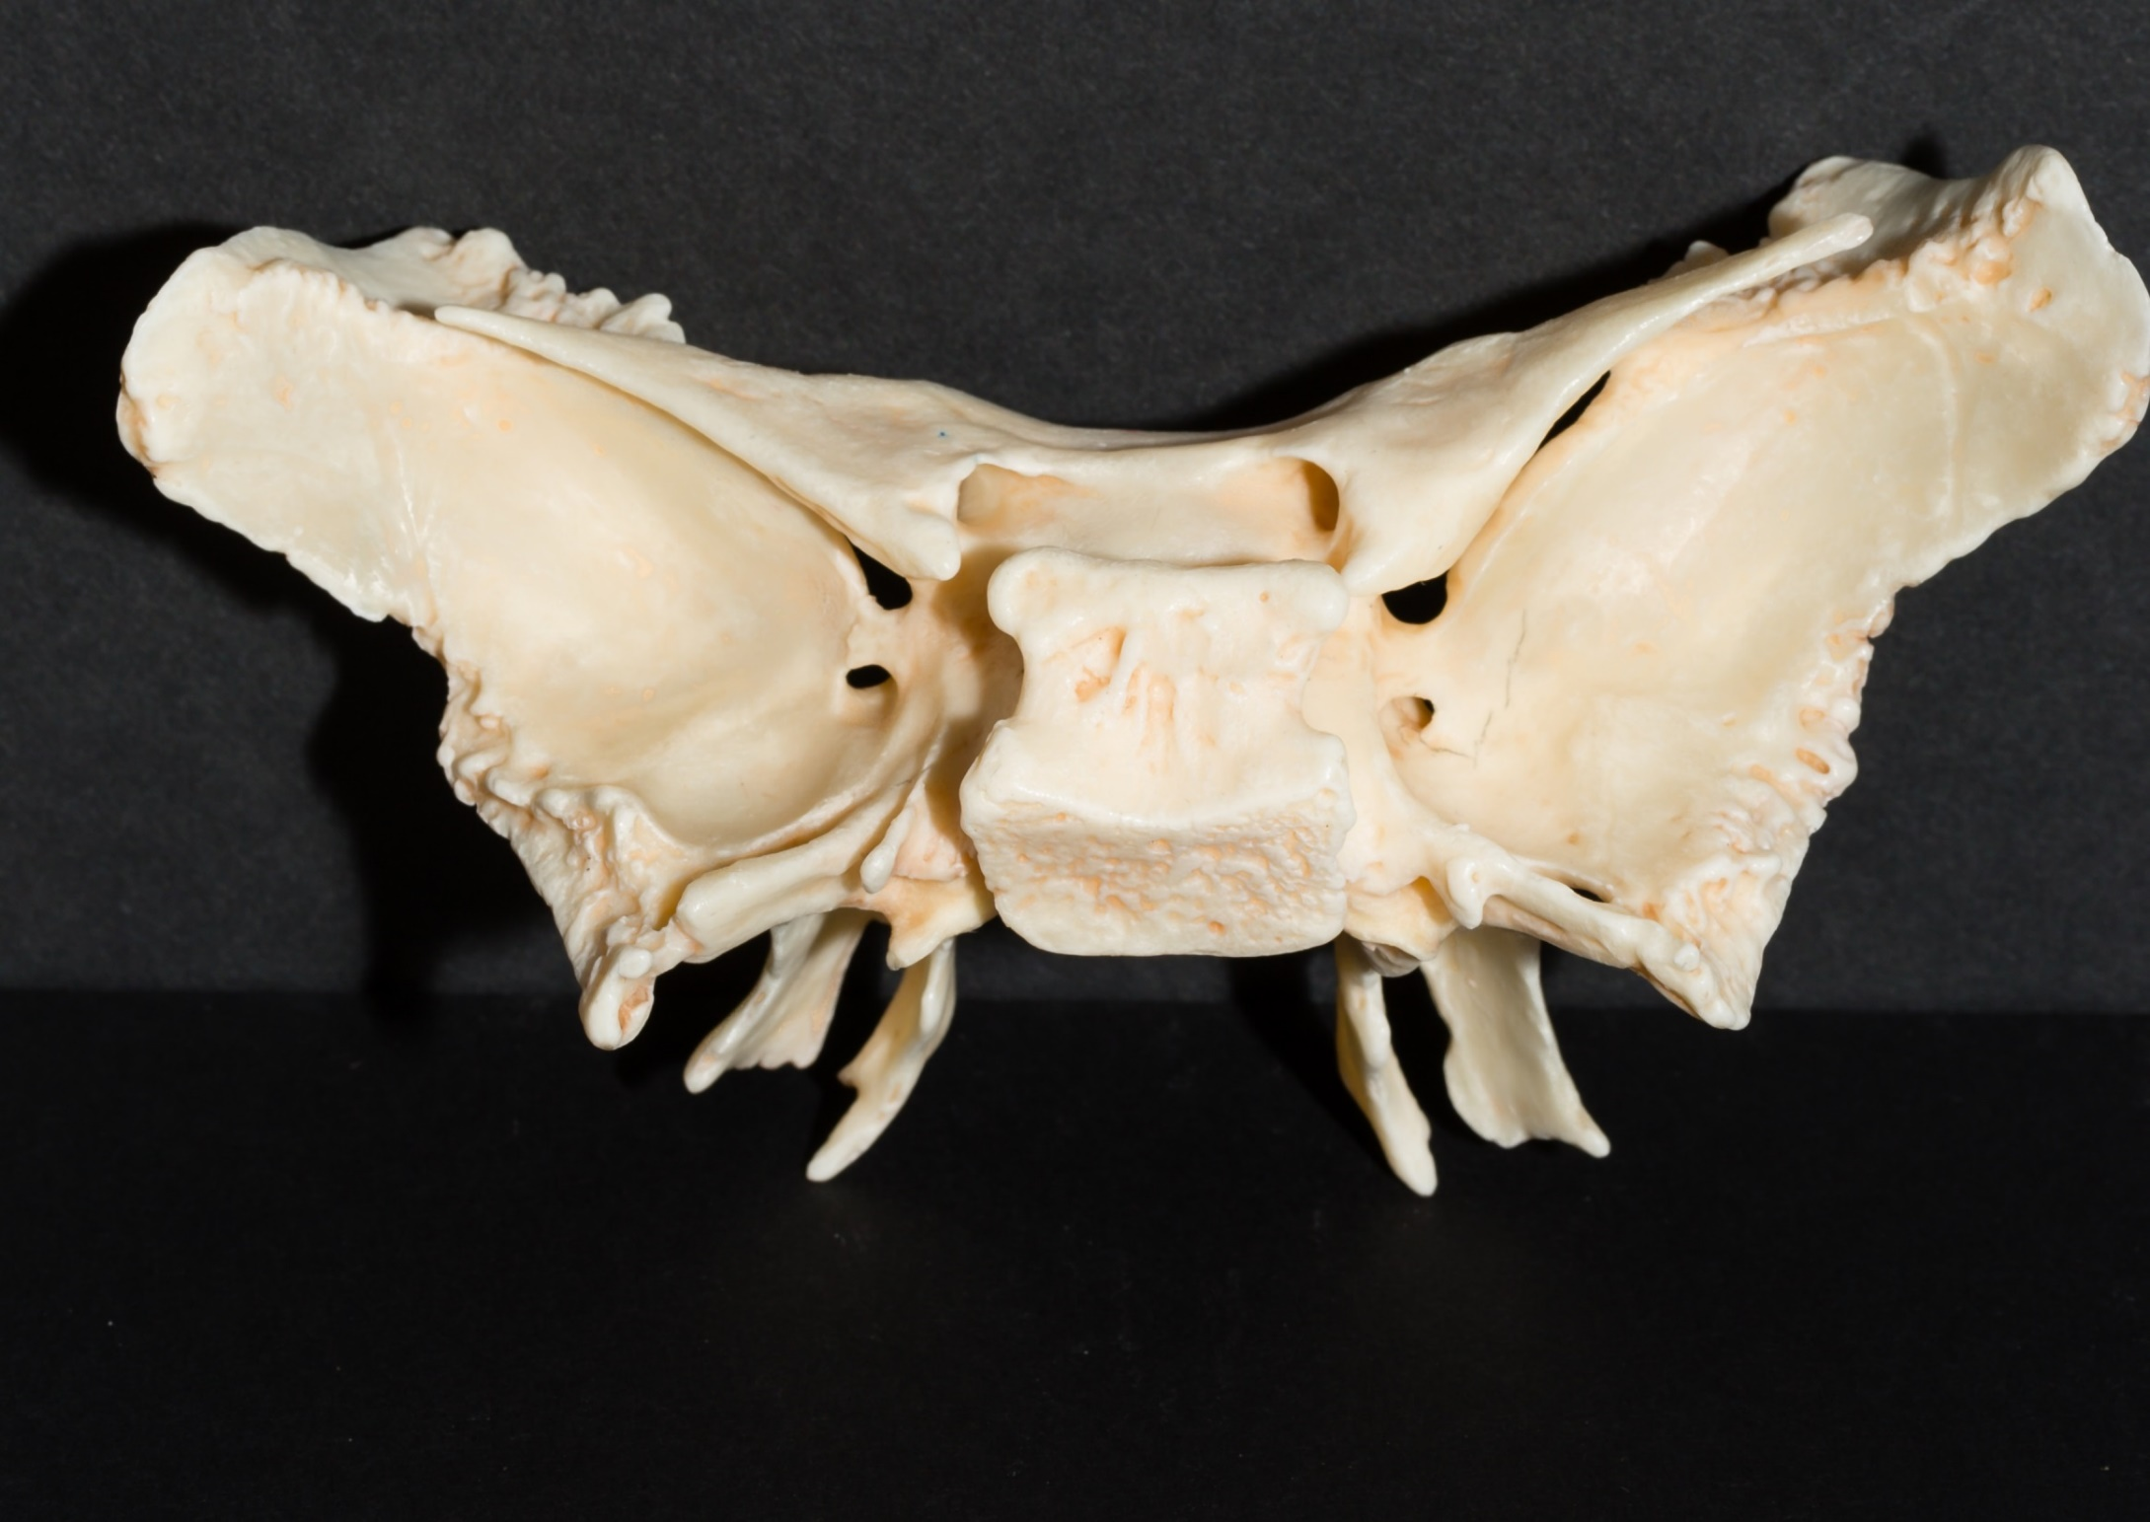
*click to the next slide to check your answer

Slide 28
Sella turcica of the sphenoid

Slide 29
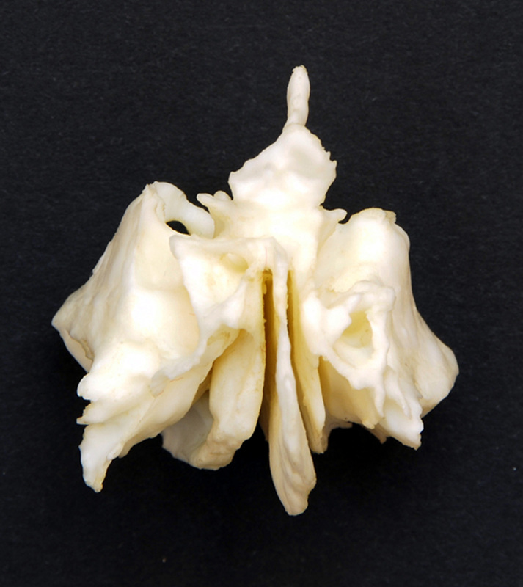
*click to the next slide to check your answer

Slide 30
Crista galli of the ethmoid

Slide 31
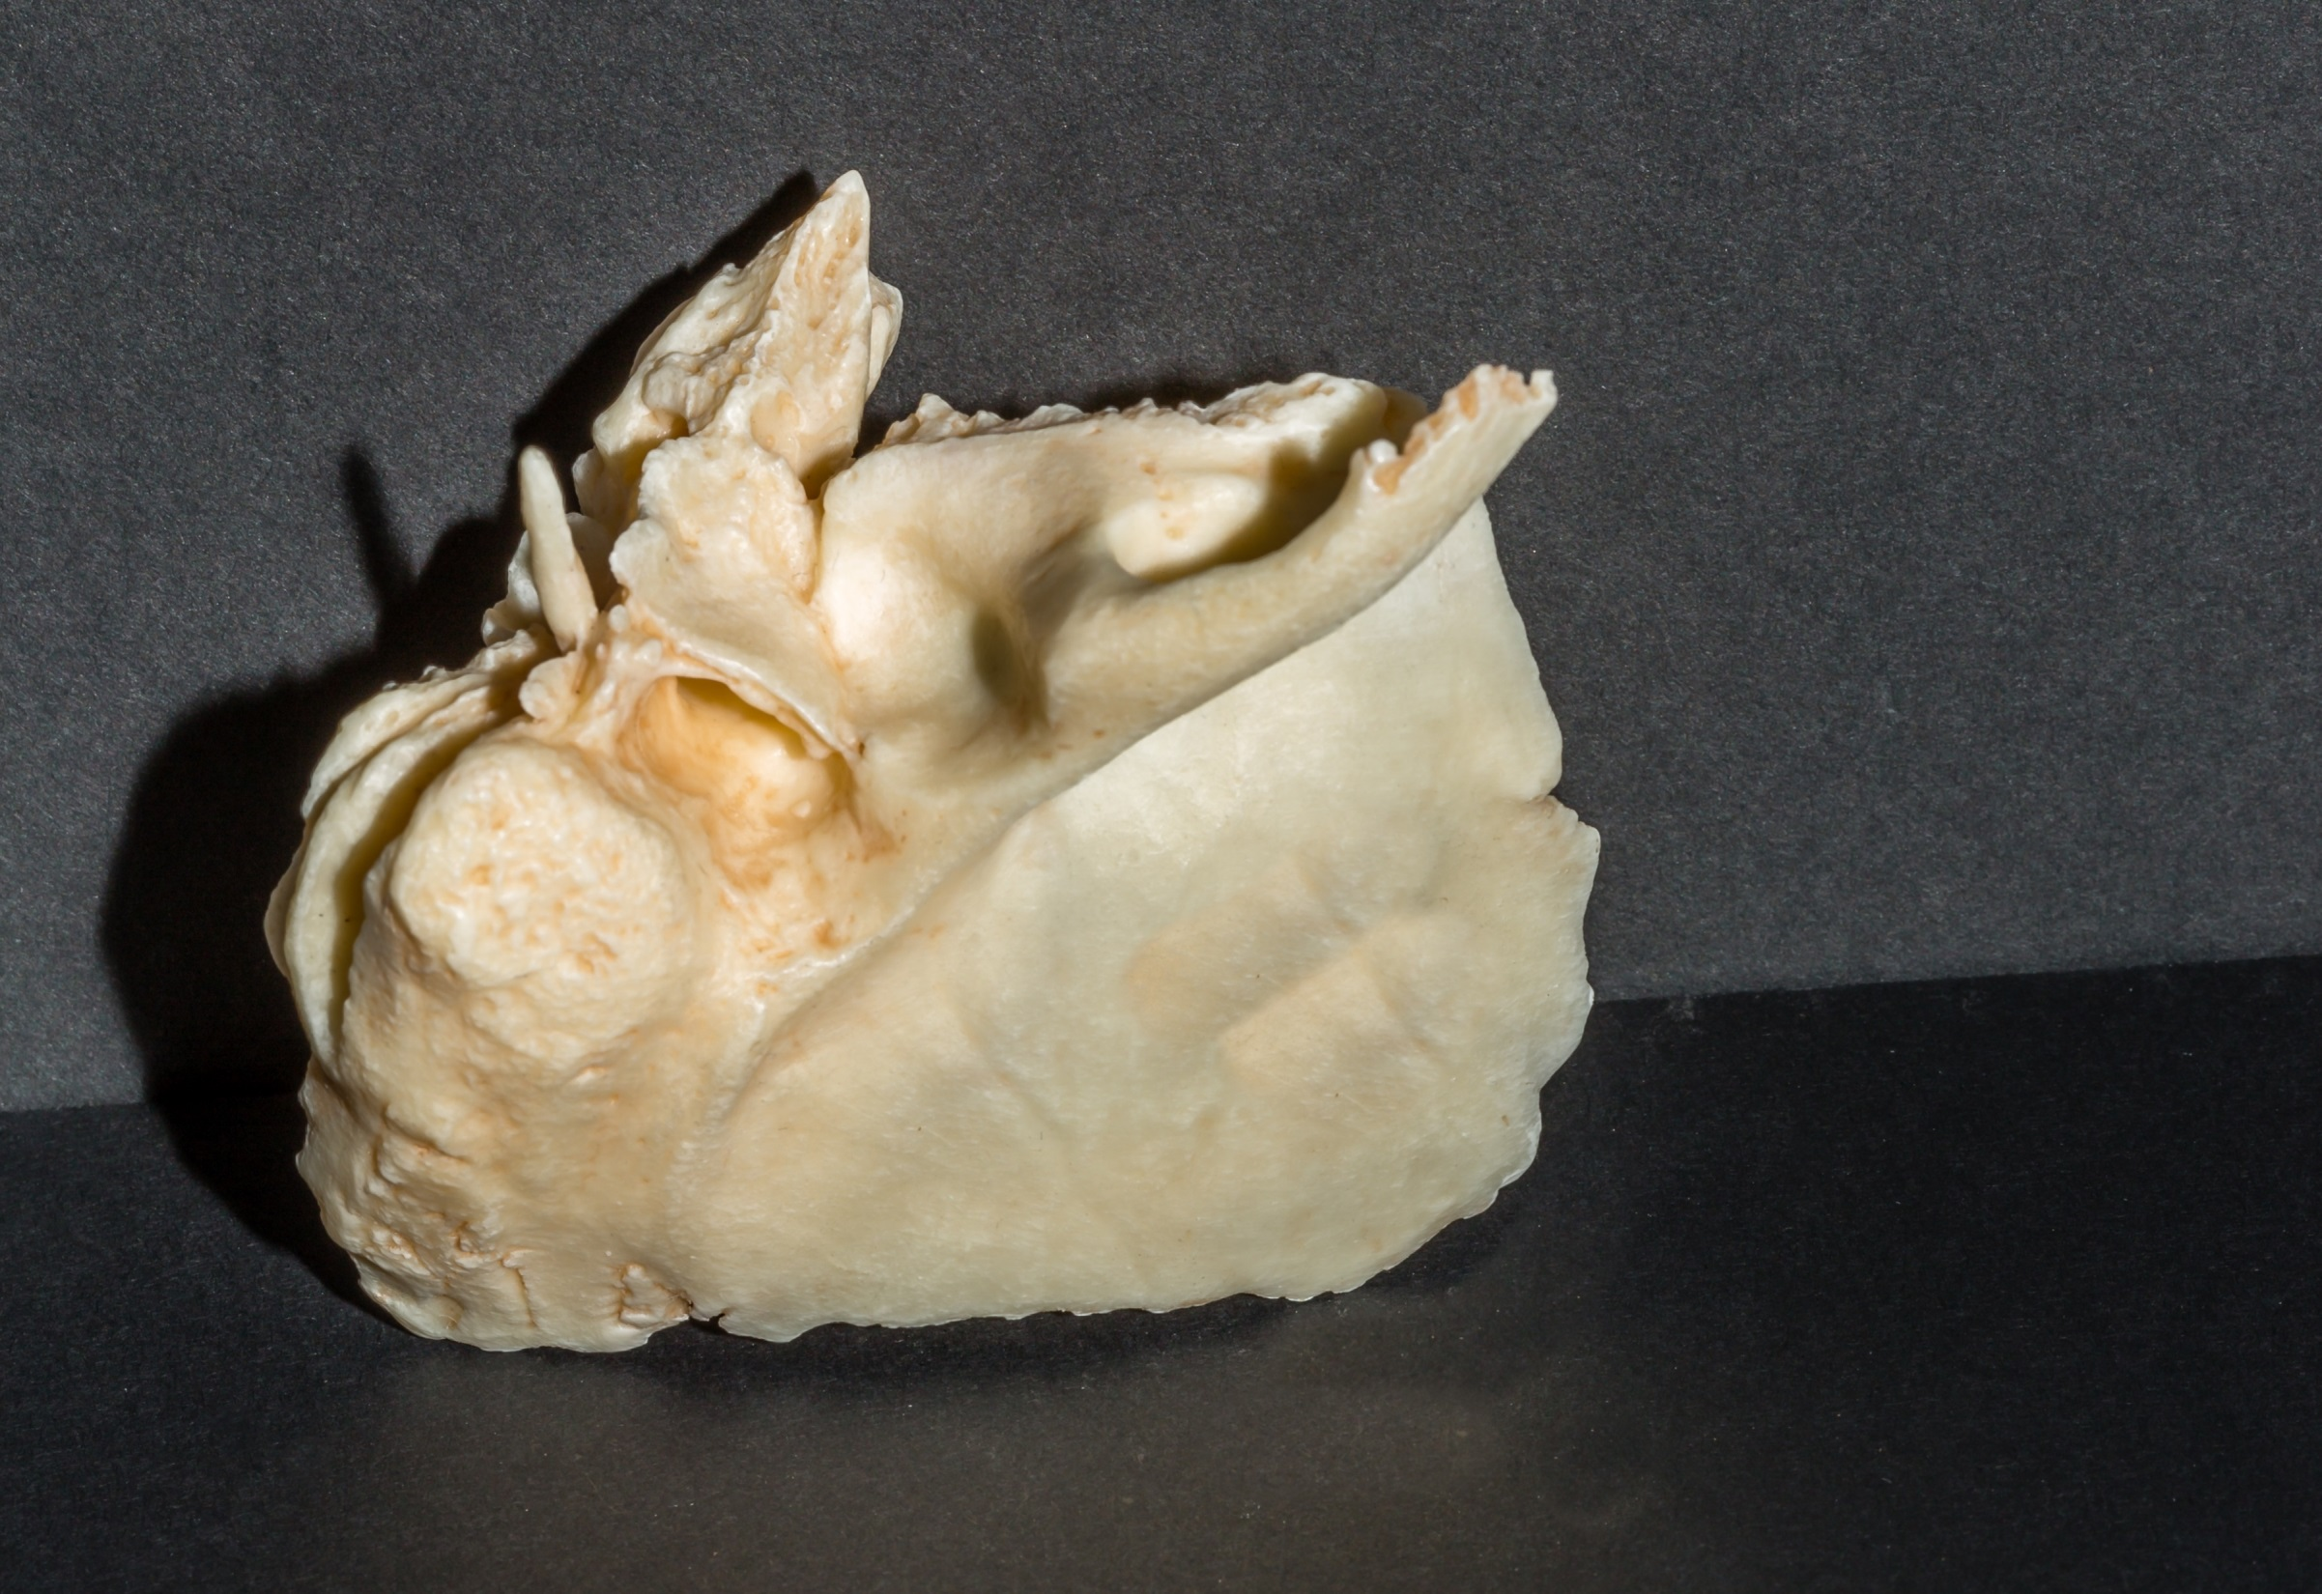
*click to the next slide to check your answer

Slide 32
External auditory (acoustic) meatus of temporal

Slide 33
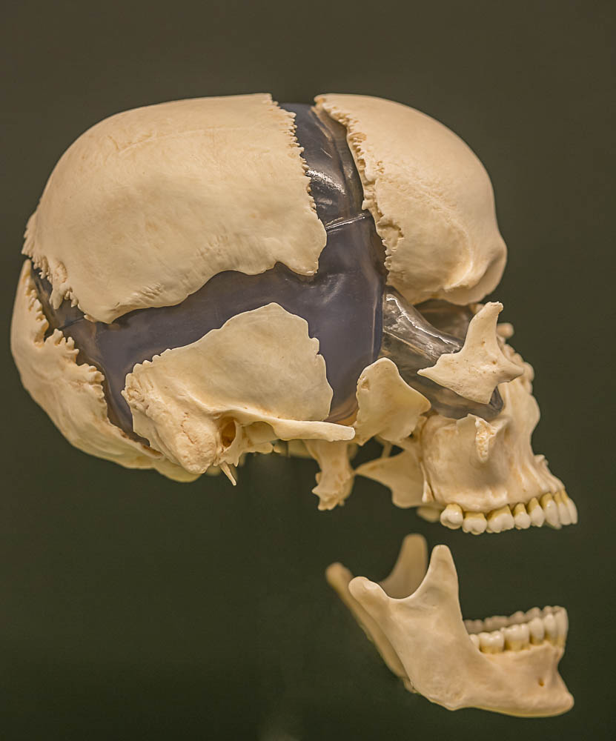
*click to the next slide to check your answer

Slide 34
Parietal bone

Slide 35
*click to the next slide to check your answer

Slide 36
Mastoid process of the temporal bone

Slide 37
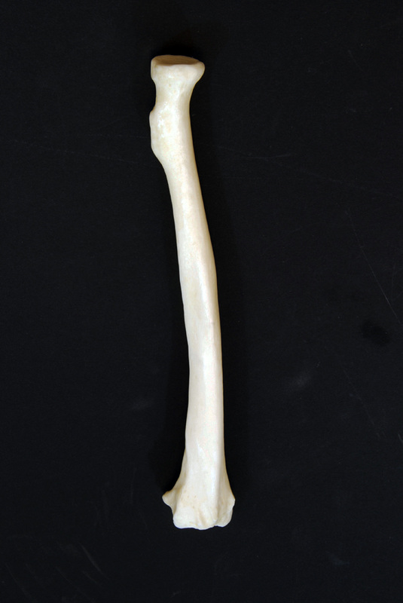
*click to the next slide to check your answer

Slide 38
Radial tuberosity

Slide 39
*click to the next slide to check your answer

Slide 40
Mandibular condyle

Slide 41
*click to the next slide to check your answer

Slide 42
Lamina of typical cervical vertebra

Slide 43
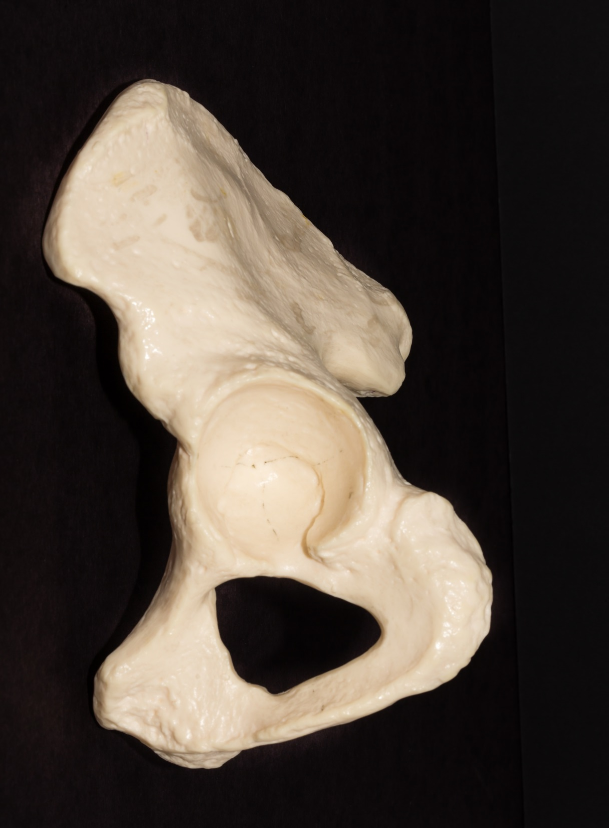
*click to the next slide to check your answer

Slide 44
Acetabulum of os coxae

Slide 45
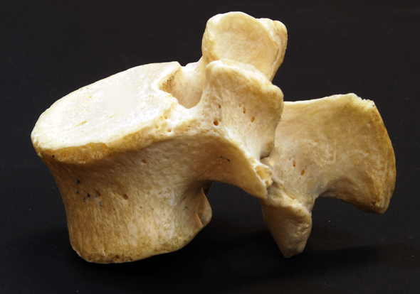
*click to the next slide to check your answer

Slide 46
Superior articular process of lumbar vertebra

Slide 47
*click to the next slide to check your answer

Slide 48
Sacral foramina

Slide 49
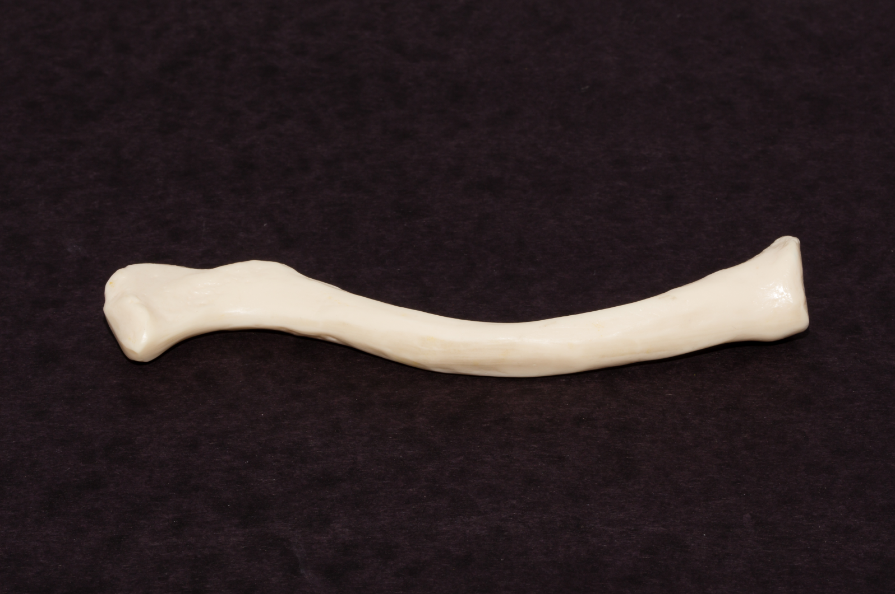
*click to the next slide to check your answer

Slide 50
Acromial end of clavicle

Slide 51
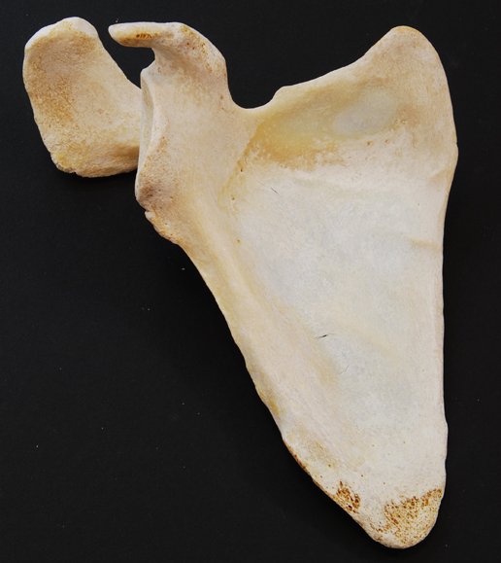
*click to the next slide to check your answer

Slide 52
Coracoid process of the scapula

Slide 53
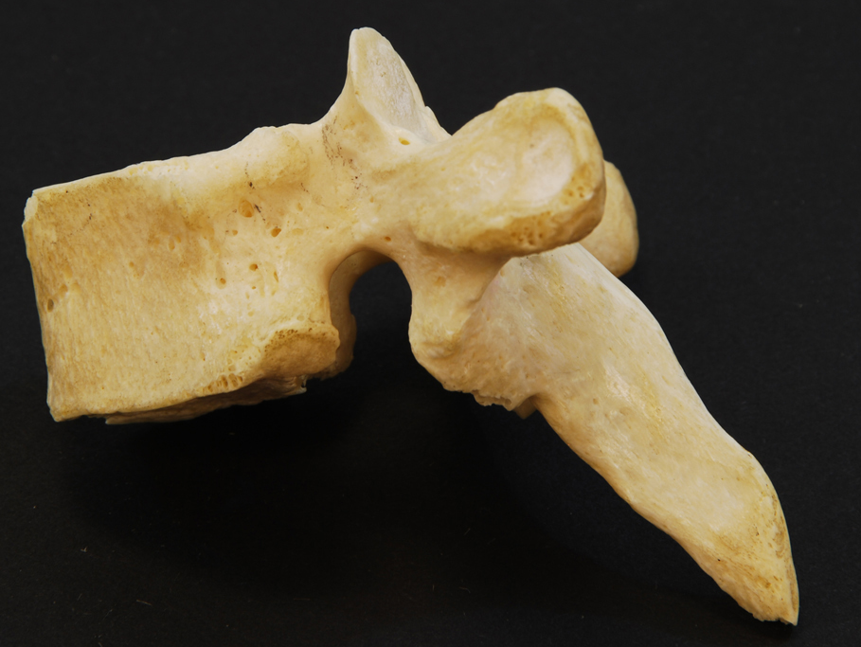
*click to the next slide to check your answer

Slide 54
Inferior costal facet of thoracic

Slide 55
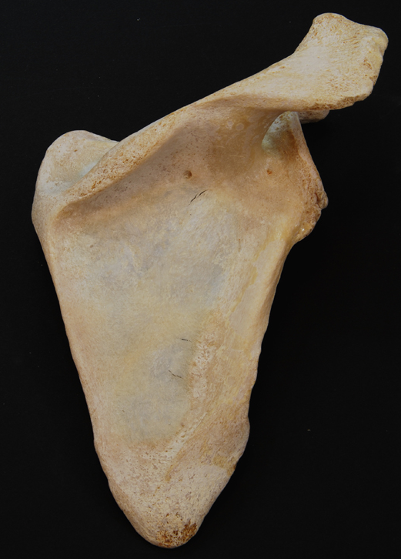
*click to the next slide to check your answer

Slide 56
Spine of the scapula

Slide 57
*click to the next slide to check your answer

Slide 58
Greater tubercle of humerus

Slide 59
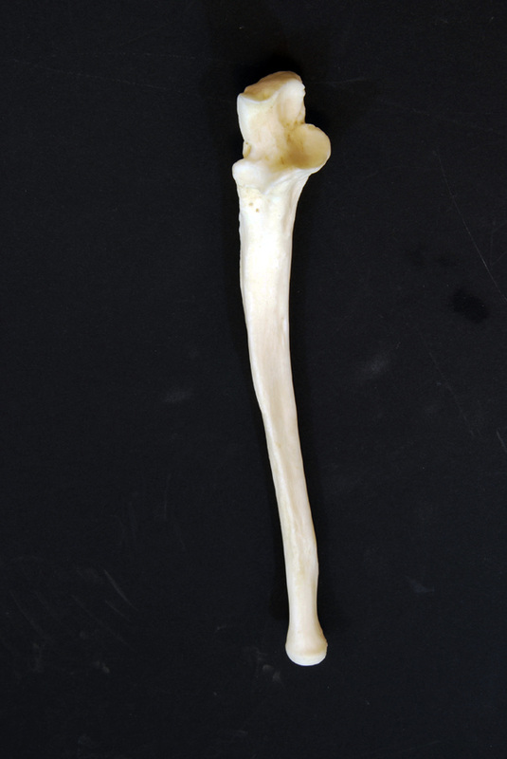
*click to the next slide to check your answer

Slide 60
Coronoid process of ulna

Slide 61
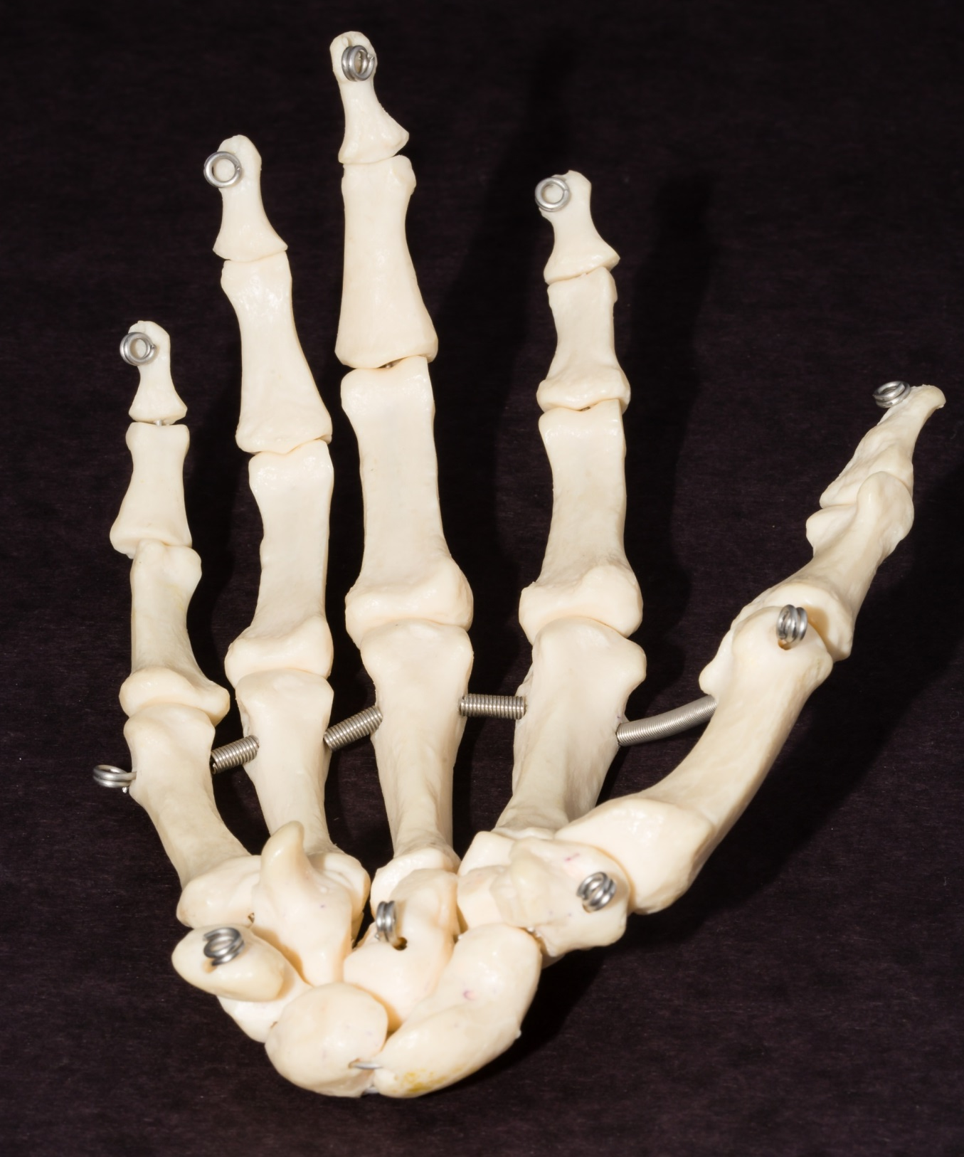
*click to the next slide to check your answer

Slide 62
Scaphoid

Slide 63
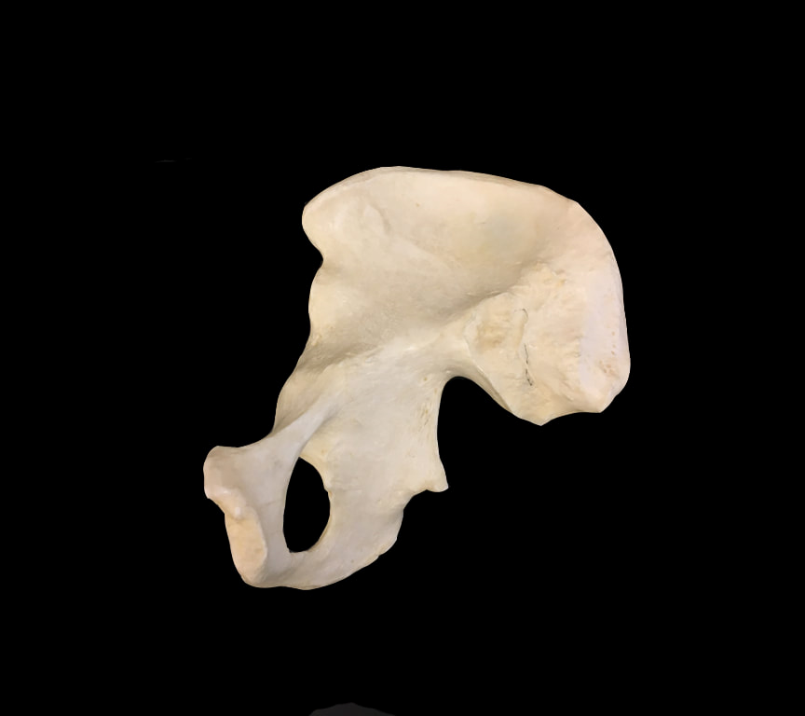
*click to the next slide to check your answer

Slide 64
Ischial spine

Slide 65
*click to the next slide to check your answer

Slide 66
Distal phalanx of pollex (upper extremity digit I)

Slide 67
*click to the next slide to check your answer

Slide 68
Medial epicondyle of humerus

Slide 69
*click to the next slide to check your answer

Slide 70
Head of metacarpal II

Slide 71
*click to the next slide to check your answer

Slide 72
Anterior superior iliac spine

Slide 73
*click to the next slide to check your answer

Slide 74
Pubic symphysis

Slide 75
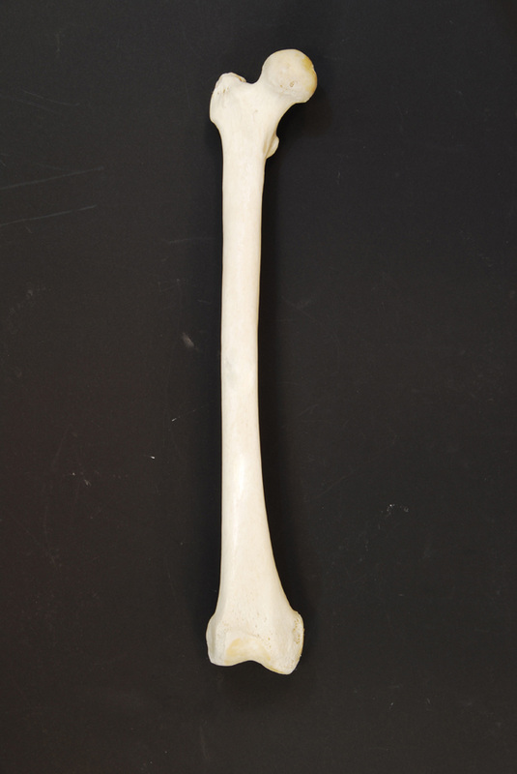
*click to the next slide to check your answer

Slide 76
Greater trochanter of femur

Slide 77
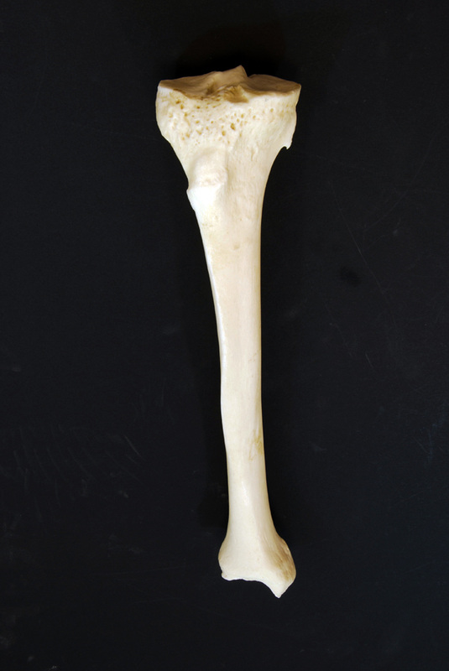
*click to the next slide to check your answer

Slide 78
Tibial tuberosity

Slide 79
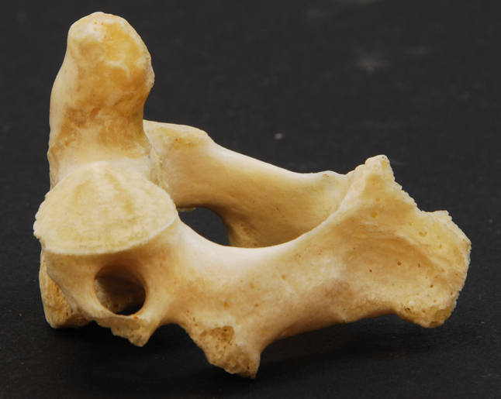
*click to the next slide to check your answer

Slide 80
Dens (odontoid process) of C2

Slide 81
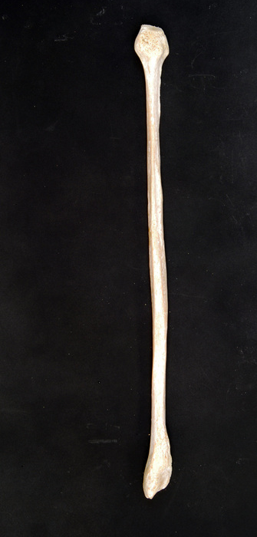
*click to the next slide to check your answer

Slide 82
Lateral malleolus of fibula

Slide 83
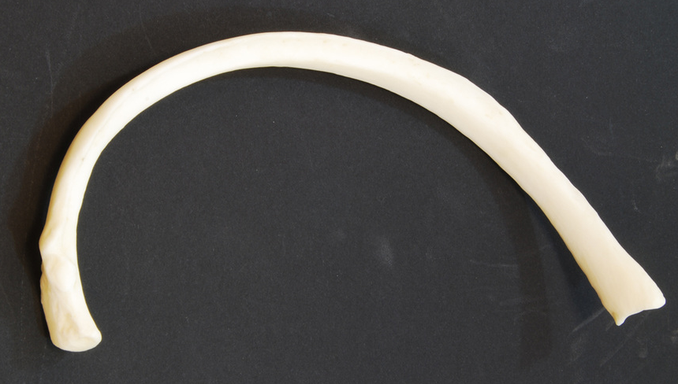
*click to the next slide to check your answer

Slide 84
Head of rib

Slide 85
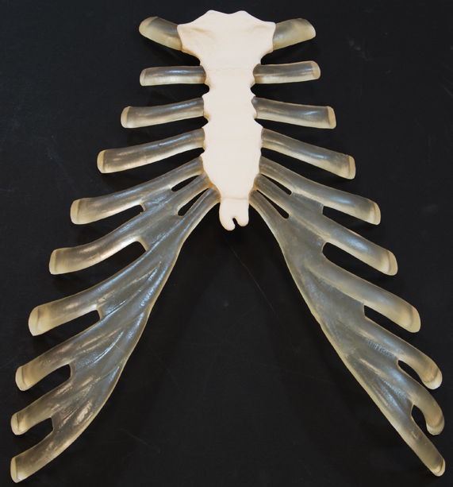
*click to the next slide to check your answer

Slide 86
Xiphoid process of sternum

Slide 87
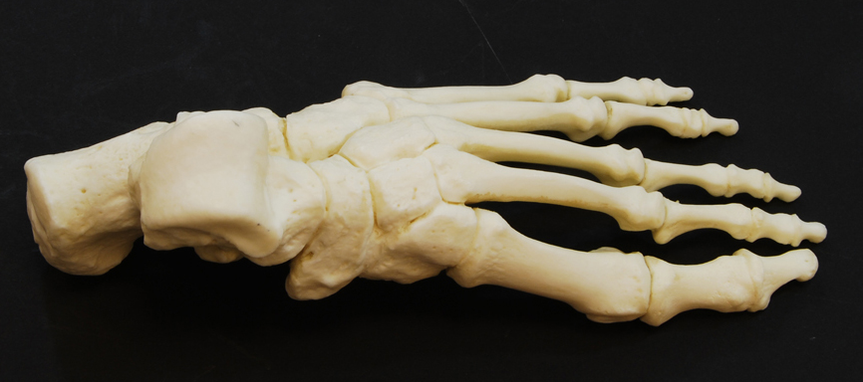
*click to the next slide to check your answer

Slide 88
Talus

